Slide 1

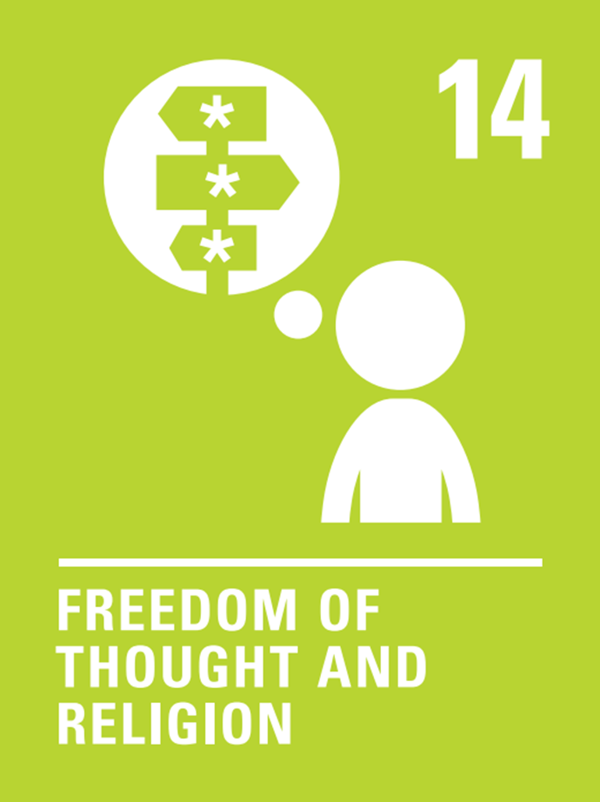

Right of the Fortnight
Who or what influences the way you think about the world and shapes your thoughts and belief?
Your cultural background and heritage
Friends
Family
School
Your religion
Social media
Personal life experiences
Your family history
Politicians
Celebrities
Children have the right to think and believe what they want and to practise their religion
Think about it?
Many religious stories we learn about help us to understand the importance of being kind and respectful and of looking after each other.
BE KIND
BE RESPECTFUL
BE THE BEST THAT YOU CAN BE
12th – 23rd January

Slide 2
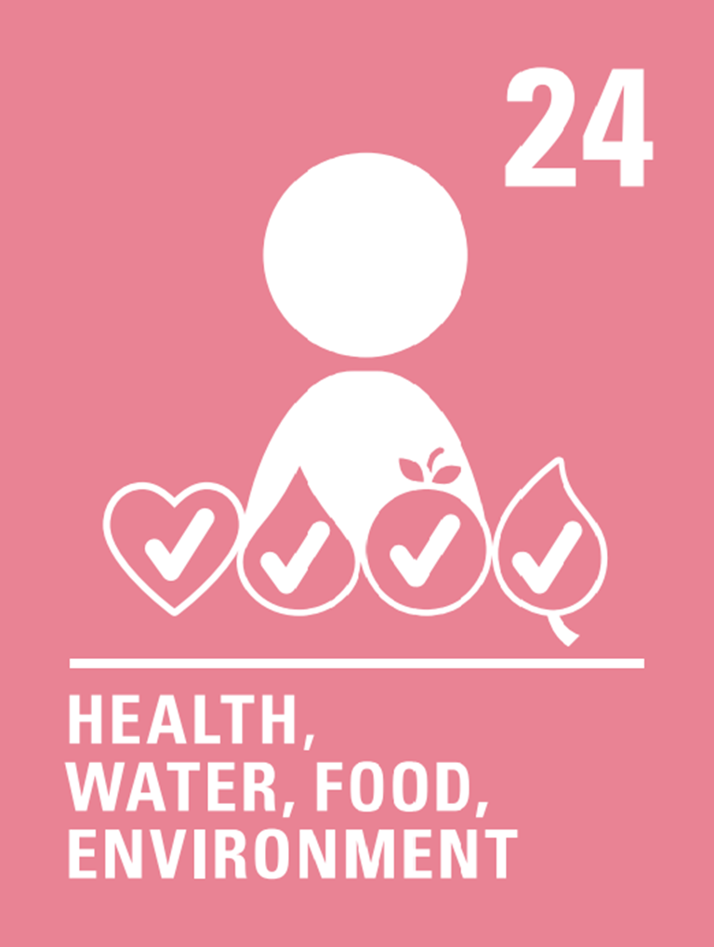
Right of the Fortnight
The right to good health
What do we need to keep ourselves healthy?
Enough sleep
Nutritious Food- healthy food helps us learn as well!
Water – at least a litre a day
Keeping our bodies clean
Exercise
A clean environment
Learning how to protect our environment
Feeling safe, secure and respected
Health care - To see a doctor or a nurse when you need to
Governments must provide good quality health care, clean water, nutritious food, and a clean environment and education on health and well-being so that children can stay healthy.
TOP TIP
Keep a food, drink and exercise diary for a week. Are you keeping yourself healthy?
BE KIND
BE RESPECTFUL
BE THE BEST THAT YOU CAN BE
26th – January – 6th February

Slide 3
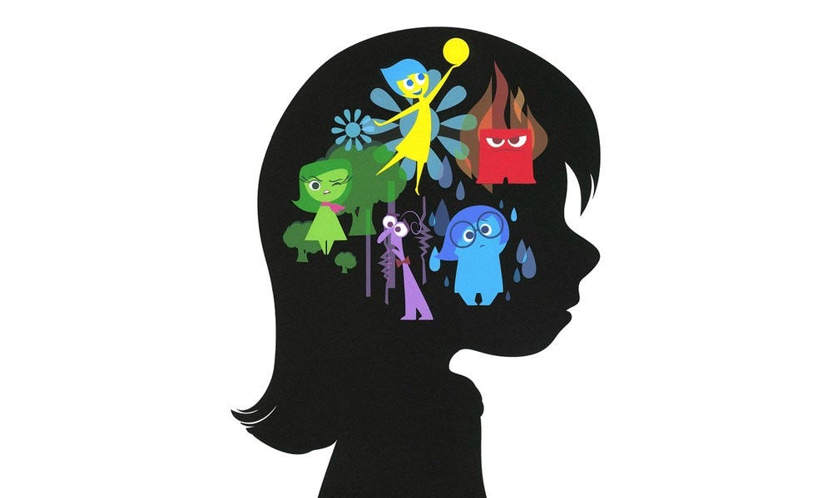


Right of the Fortnight
Every child has the right to good health.
What do we need for positive mental health?
Understand that at times it’s OK to be sad or worried.
Exercise regularly
Have a healthy diet
Have fun with family and friends
Being able to speak to a trusted adult
What is mental health?
We all have mental health. Your mental health affects how you feel, think and act.
Top Tip
Showing respect or a lack of respect can affect everybody both children and adults and make a positive or negative difference to their mental health and how they feel.
BE KIND
BE RESPECTFUL
BE THE BEST THAT YOU CAN BE
9th – 20th February

Slide 4

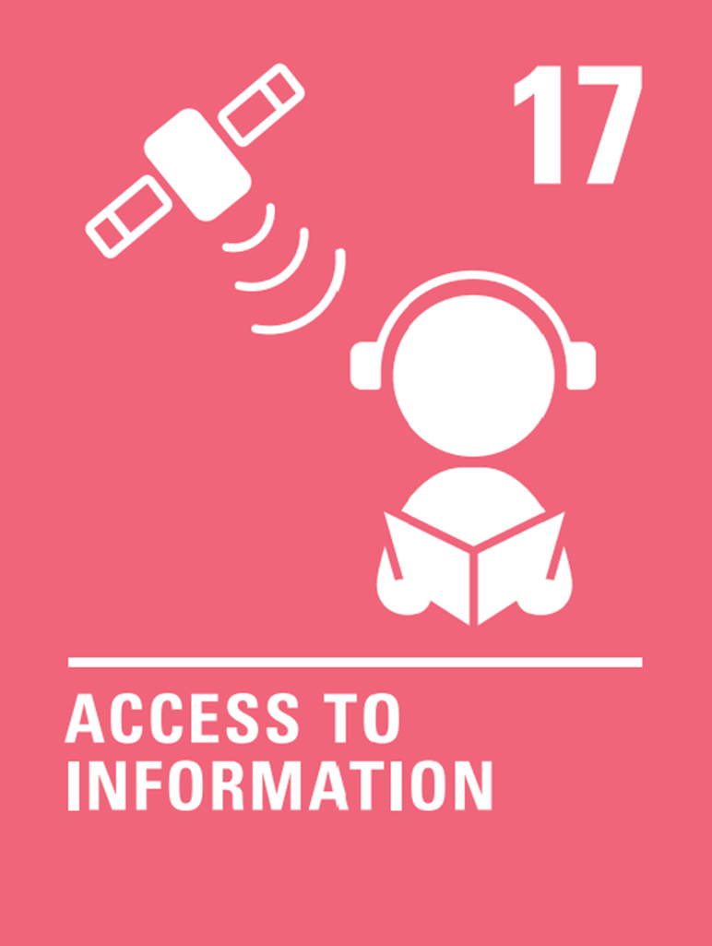

Right of the Fortnight
Children have the right to reliable information
Why is it important to recognise reliable information?
To be able to confidently discuss information with others. To know that it’s okay to ask more questions if something doesn't seem right.
To learn the difference between a fact and an opinion.
So that we can have healthy discussions based on facts.
To feel confident to say, ‘I’m not sure if that’s true’.
To know that some people deliberately put false information online.
Know when to speak to an adult ore report an issue.
Think about it?
To make sure that children are protected from harmful information films and computer games all have different classifications.
BE KIND
BE RESPECTFUL
BE THE BEST THAT YOU CAN BE
10th – 14th February

