Slide 1

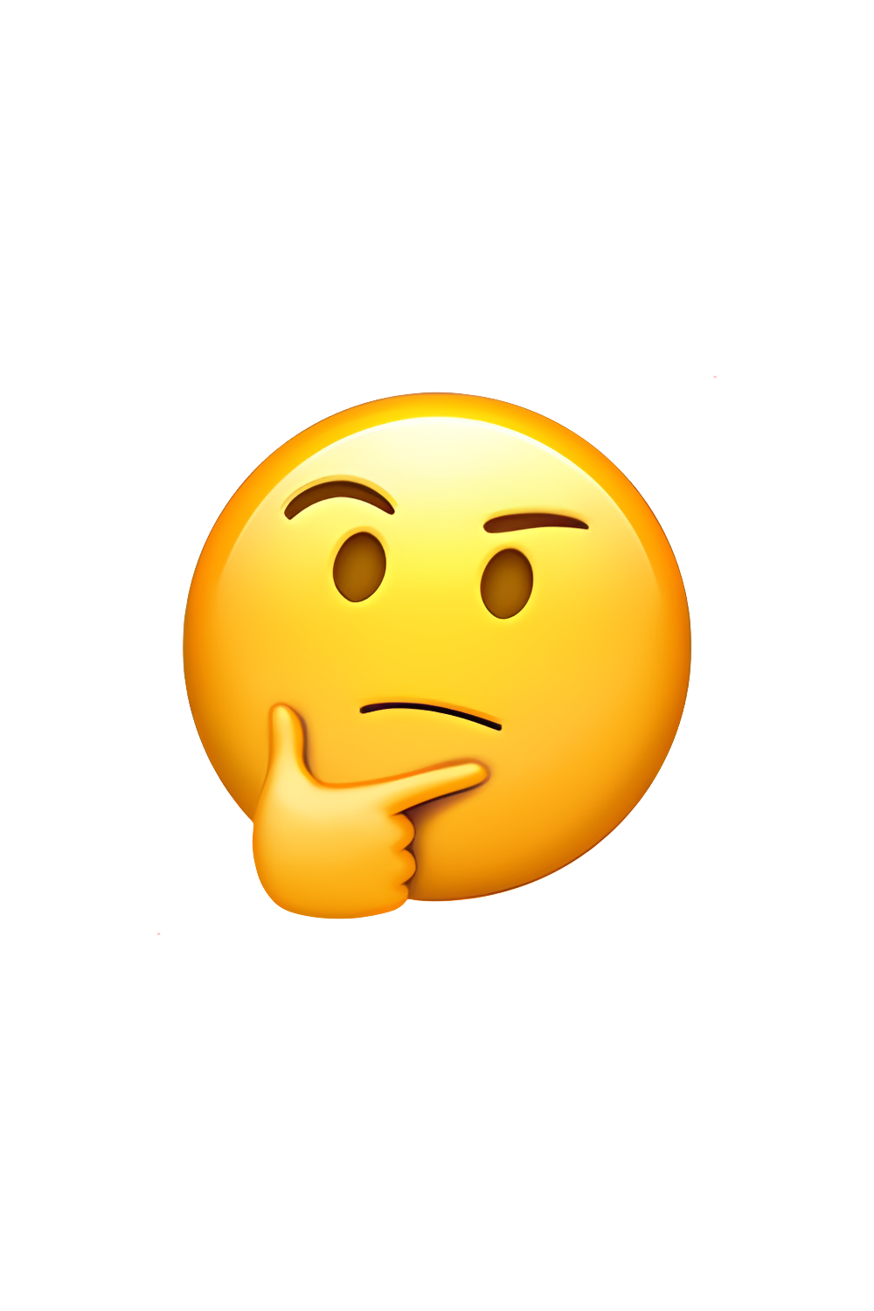
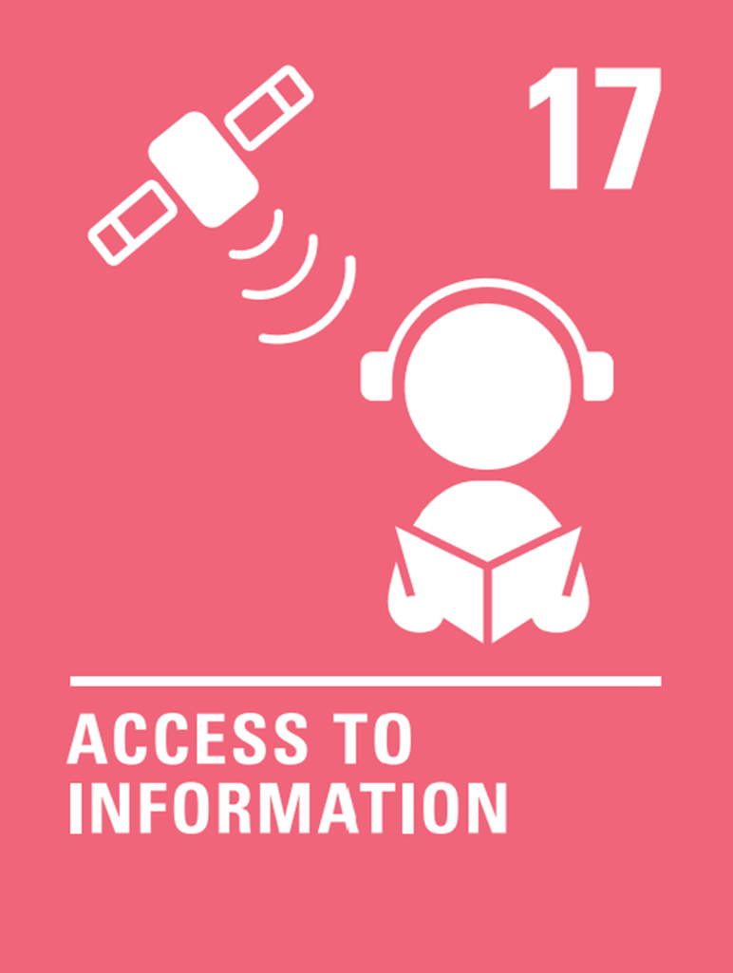
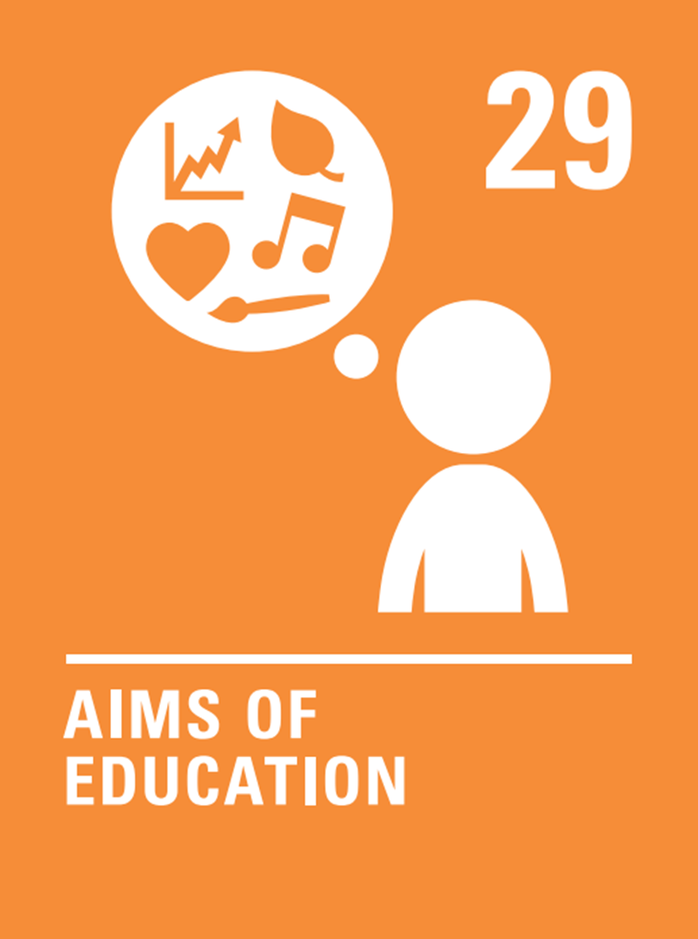
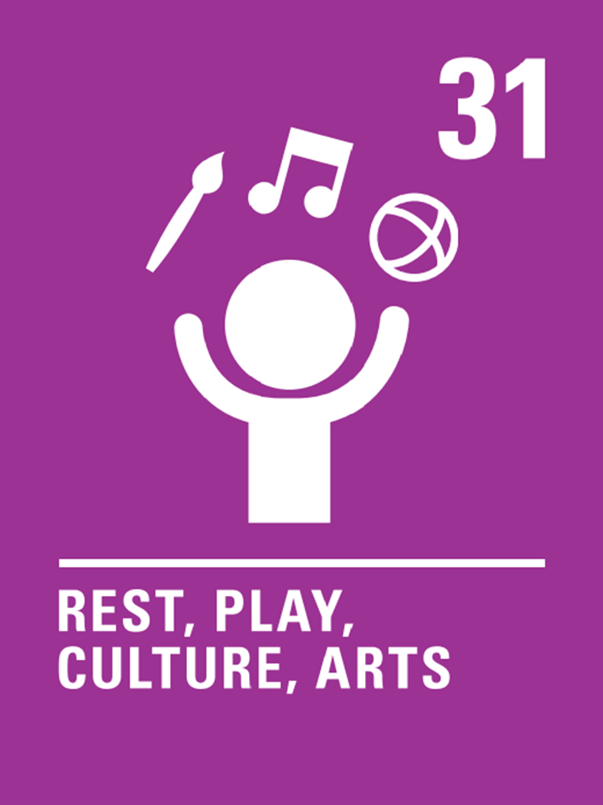

Rights of the Fortnight
BE KIND
BE RESPECTFUL
BE THE BEST THAT YOU CAN BE
Think about it!
Books and reading support your rights.
Reading books
Gives you information
Develop you as a person
Helps you to relax
How can reading help us?
Learn new things.
Reading inspires us.
Learn new things and learn about the world.
It is a good alternative to spending time on a screen.
We can get ideas for our own writing and stories.
World Book Day
Thursday 5th March
23rd February – 6th March

Slide 2

Right of the Fortnight
Children who have any kind of disability should receive special care and support so that they can live a full and independent life.
.
Sign language is a way of communicating using your hands. It is not only used by some people with hearing loss but helps with other communication disabilities too.
Watch this!
https://youtu.be/YtAi0R83qzU
.
There are millions of people with disabilities – they should feel part of society.
Not every disability can be seen eg diabetes, dyslexia.
Sometimes people are unkind about disability and may say or do hurtful things.
People who are disabled have all the rights that everyone else has.
BE KIND
BE RESPECTFUL
BE THE BEST THAT YOU CAN BE
9th March – 20th March

Slide 3
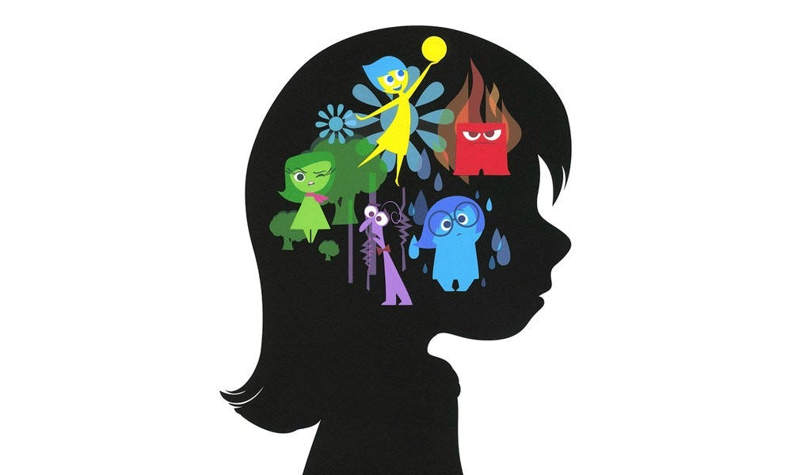
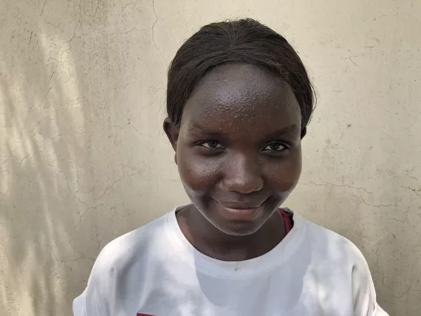
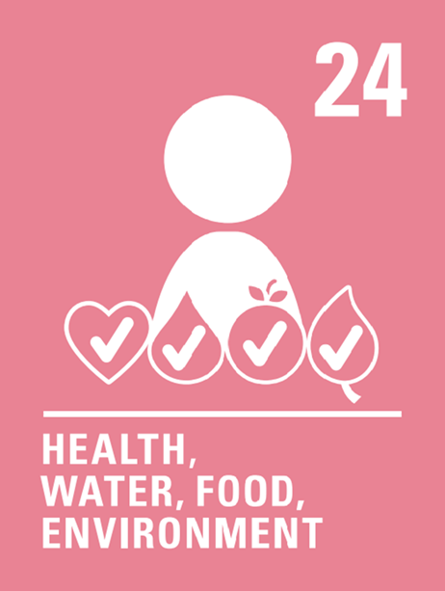
Right of the Fortnight
Every child has the right to good health including clean water
Why do you think that the right to clean water is such an important right?
World Water Day Sunday 22nd March 2026
Celebrates water and raises awareness of the 2 billion people living without access to safe water.
Our bodies are made up of over 60% water and we need clean water to keep them working properly and to stay alive.
Drinking unsafe water can cause serious illnesses.
In some communities, children miss out on their education because they must spend time collecting water.
We need water for washing ourselves and for keeping our clothes and homes clean and flushing toilets
Water provides important habitats for plants and animals.
Pollution of our oceans, rivers and waterways can have a serious impact on all living things.
“Water is a source of life. Water is our everything. Without it, we have nothing completely, no crops , no food, no survival, no life. Together, we must protect it.”
Christine Saida, Age 14
South Sudan
BE KIND
BE RESPECTFUL
BE THE BEST THAT YOU CAN BE
23rd March – 27th March

