Slide 1



Right of the Fortnight
Children have great ideas!
Sharing views prepares you for being an adult
Being involved makes you feel part of a community
TOP TIP
Listen to others and allow them to share their views.
Take turns to speak.
BE KIND
BE RESPECTFUL
BE THE BEST THAT YOU CAN BE
15th September – 19th September

Slide 2

Right of the Fortnight
The right to an education
You learn skills to improve things and help people
Learn how to stay safe and healthy
Helps you to get a job you enjoy and earn money in the future
Learning is fun and you can make friends
TOP TIP
Always listen and focus to ensure you and the children around you to have the right to learn.
BE KIND
BE RESPECTFUL
BE THE BEST THAT YOU CAN BE
22nd September – 3rd October

Slide 3
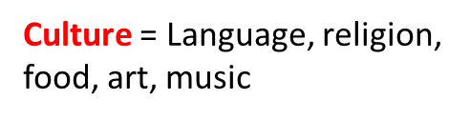


Right of the Fortnight
Every child has rights whatever their religion, gender, language, abilities or where they are from.
TOP TIP
Next time you are in the school library look for biographies about famous people from different cultures
Why is Black History Month important?
We celebrate people’s cultures and achievements
We hear a wide range of stories from the past
We learn about racism and its effects
We know to challenge racism
BE KIND
BE RESPECTFUL
BE THE BEST THAT YOU CAN BE
6th Oct – 17 ^{Oct}

Slide 4

Right of the Fortnight
The right to learn and use the customs and religion of your family
We learn about other religions
We respect all religions
We can proudly share our culture with others
TOP TIP
Listen to others about their culture and religion
Look in the library for books about other countries
Culture = Language, religion, food, art, music
BE KIND
BE RESPECTFUL
BE THE BEST THAT YOU CAN BE
20th October – 24th October

