Slide 1


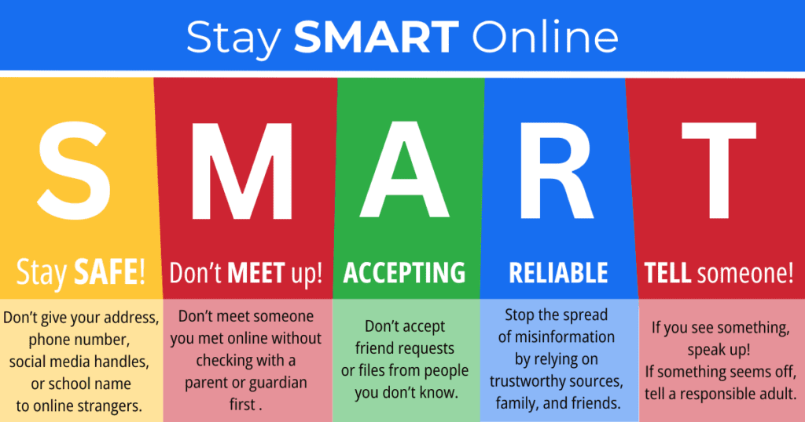

Right of the Fortnight
What needs to happen to make you feel safe?
Knowing people care about you.
Learning about why some things aren’t safe.
Knowing how to feel safe online
Feeling looked after, valued, secure and respected.
The right to be safe
TOP TIP
BE KIND
BE RESPECTFUL
BE THE BEST THAT YOU CAN BE
3rd November – 7th November (one week)

Slide 2

Right of the Fortnight
The right to be safe
Bullying is repeated behaviour that treats a person badly over time.
Bullying can be physical, verbal, online, social eg where you exclude others on purpose.
Emotional- when someone gets what they want be making others angry or sad or telling them they aren't good enough.
Anti Bullying Week 2025
TOP TIP
Always speak to an adult if somebody is making you feel uncomfortable or you see someone being unkind to another child.
BE KIND
BE RESPECTFUL
BE THE BEST THAT YOU CAN BE
10TH – 14TH November (one week)

Slide 3

Right of the Fortnight
Every child has rights whatever their religion, gender, language, abilities or where they are from.
Why is privacy important?
Children are at risk of being harmed if people know too much about them.
Not everyone should know everything about everybody they come into contact with.
Things about identity, location, health and personal life are personal to you.
It helps us to have personal space.
TOP TIP
Years 5 and 6
Think of three top tips you would give to someone new to social media to protect them from harm, now and in the future.
Right to privacy
BE KIND
BE RESPECTFUL
BE THE BEST THAT YOU CAN BE
17th – 28th November

Slide 4


Right of the Fortnight
Every child has the right to relax and play
Some of the ways we might relax and play
Just chilling out.
Spending time with friends.
Playing computer games.
Playing outdoors with friends or in a garden.
Taking part in sport.
Having a safe space to listen to music, read, draw.
Go to the cinema, visit museums.
TOP TIP
Google the name of a museum that interests you.
For example:
Natural History Museum Virtual Tour
Ask an adult to help you.
This way you can take a look inside a museum that you have wanted to visit but haven’t got there yet!
Think about how we help one another enjoy the right to play
BE KIND
BE RESPECTFUL
BE THE BEST THAT YOU CAN BE
1st– 12th December

