Slide 1




Slide 2

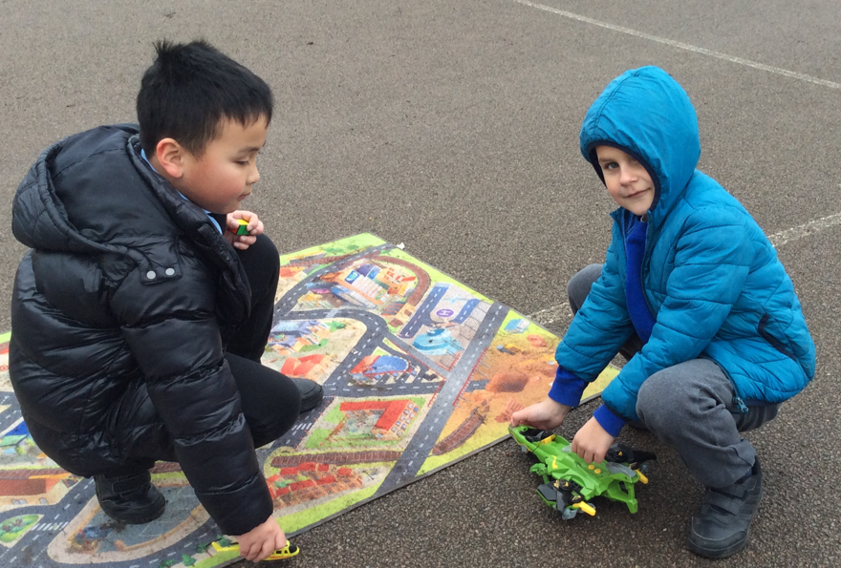
Communication and role play

Slide 3
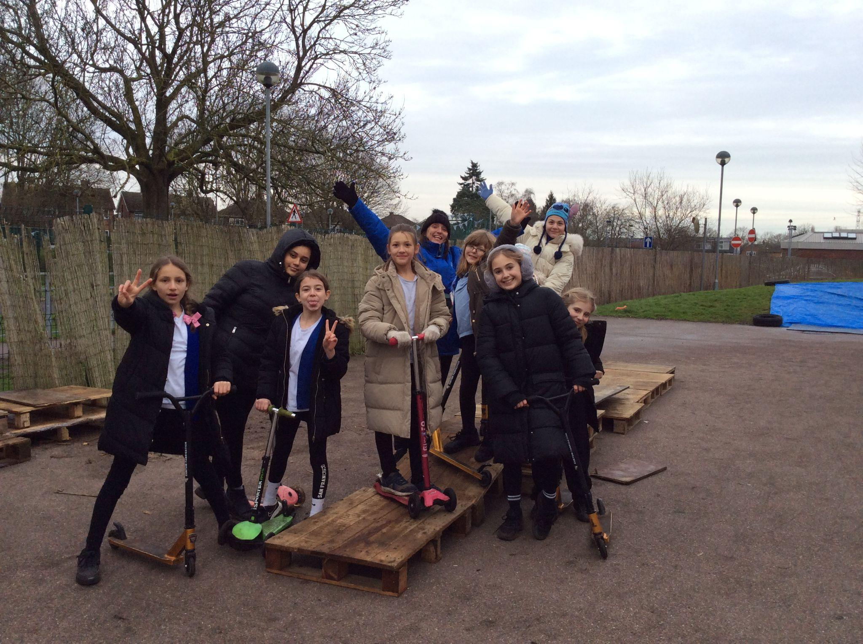
Team work
Physical play

Slide 4
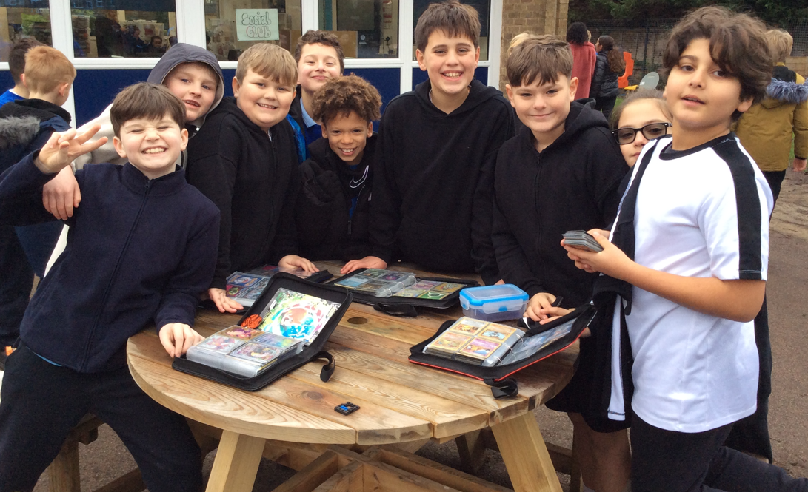

Slide 5

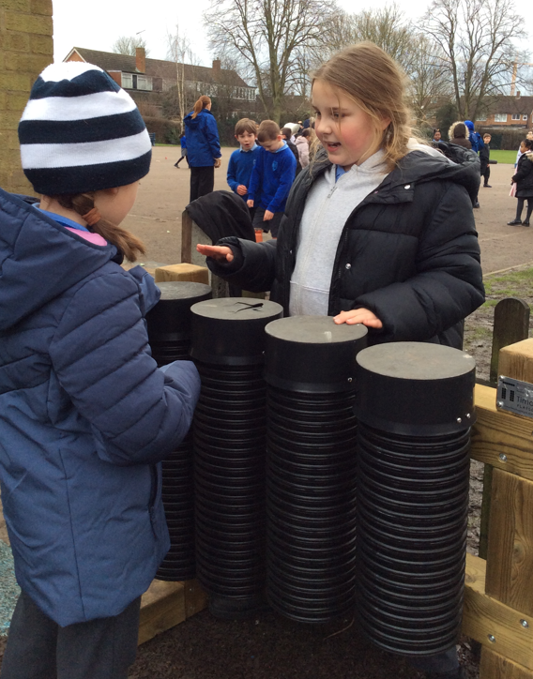
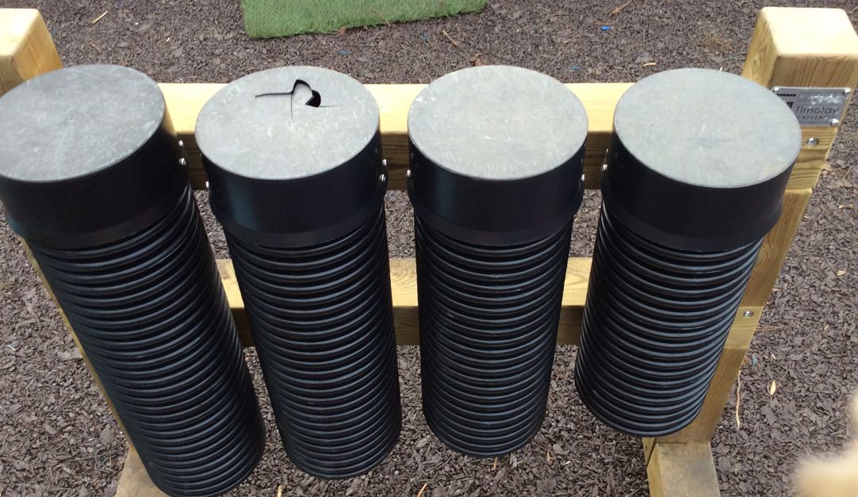
We play with the equipment carefully

Slide 6
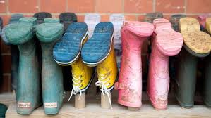
We all bring wellies to school

Slide 7

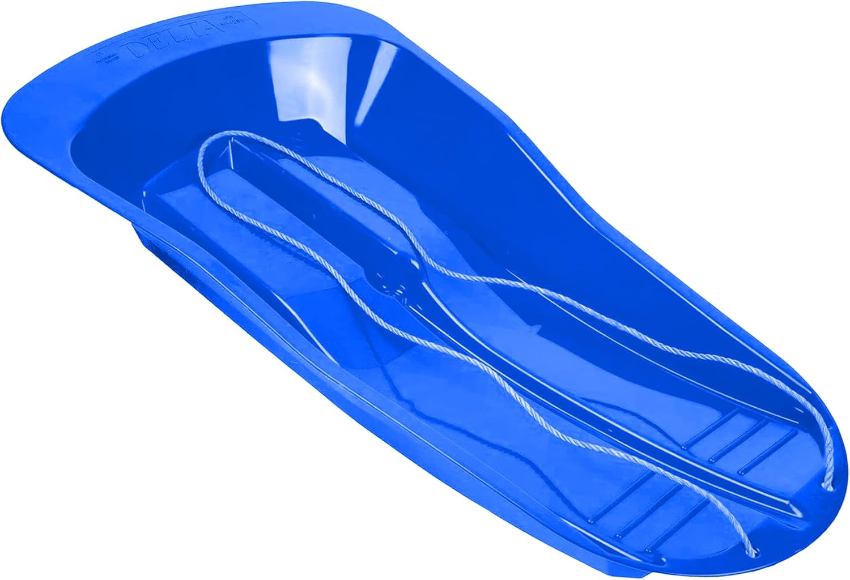
Sleigh
These belong on the hill

Slide 8
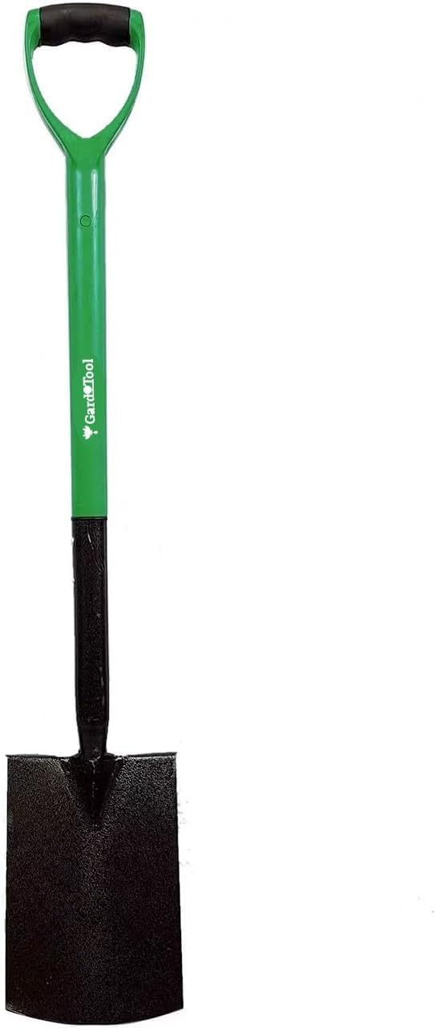
Large spades
These belong in the digging area
Rules and expectations

Slide 9
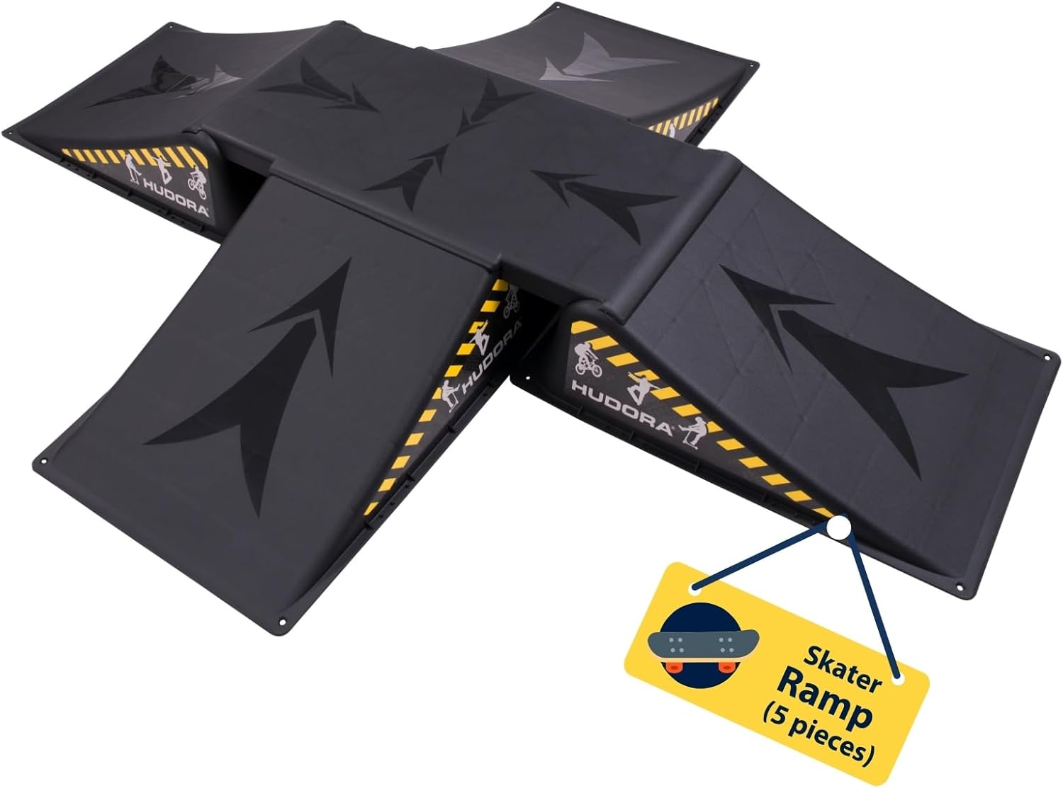
Ramps
These will belong in the wheeled area

Slide 10
Expectations in the gazebo area
Anyone can access it
It has become a space for performing and role play
Treat it with respect
Respect the flowers and plants around the gazebo
Be mindful of others - DO NOT RUN
What does that look like?
How should this area be left at the end of each lunch time?

Slide 11


The OPAL play team are on the hunt for examples of excellent OPAL, across all of the ranges.
What does creativity look like:
On the field?
In the wheeled area?
On the hill?
By the dens?
In the mud kitchen?
Amongst the small world equipment?

Slide 12
We are on the hunt for OPAL investigators.
These children will be responsible for identifying good OPAL examples across the school and will use ipads to record their findings.

