Slide 1




Slide 2


Slide 3

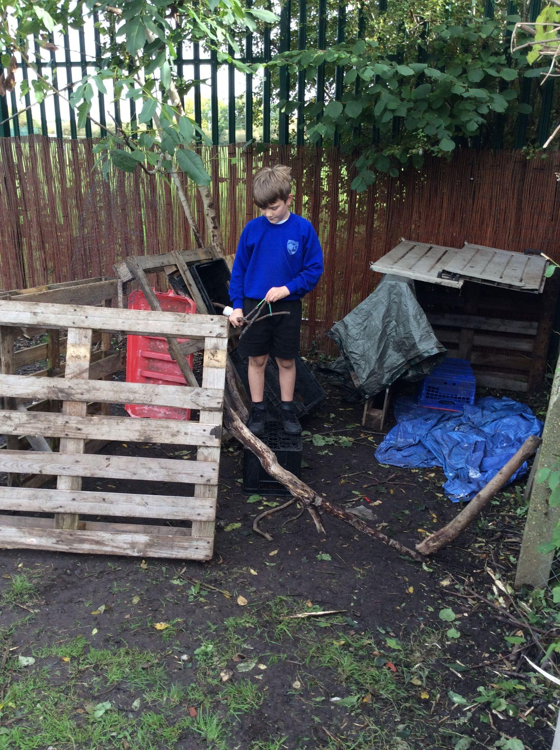
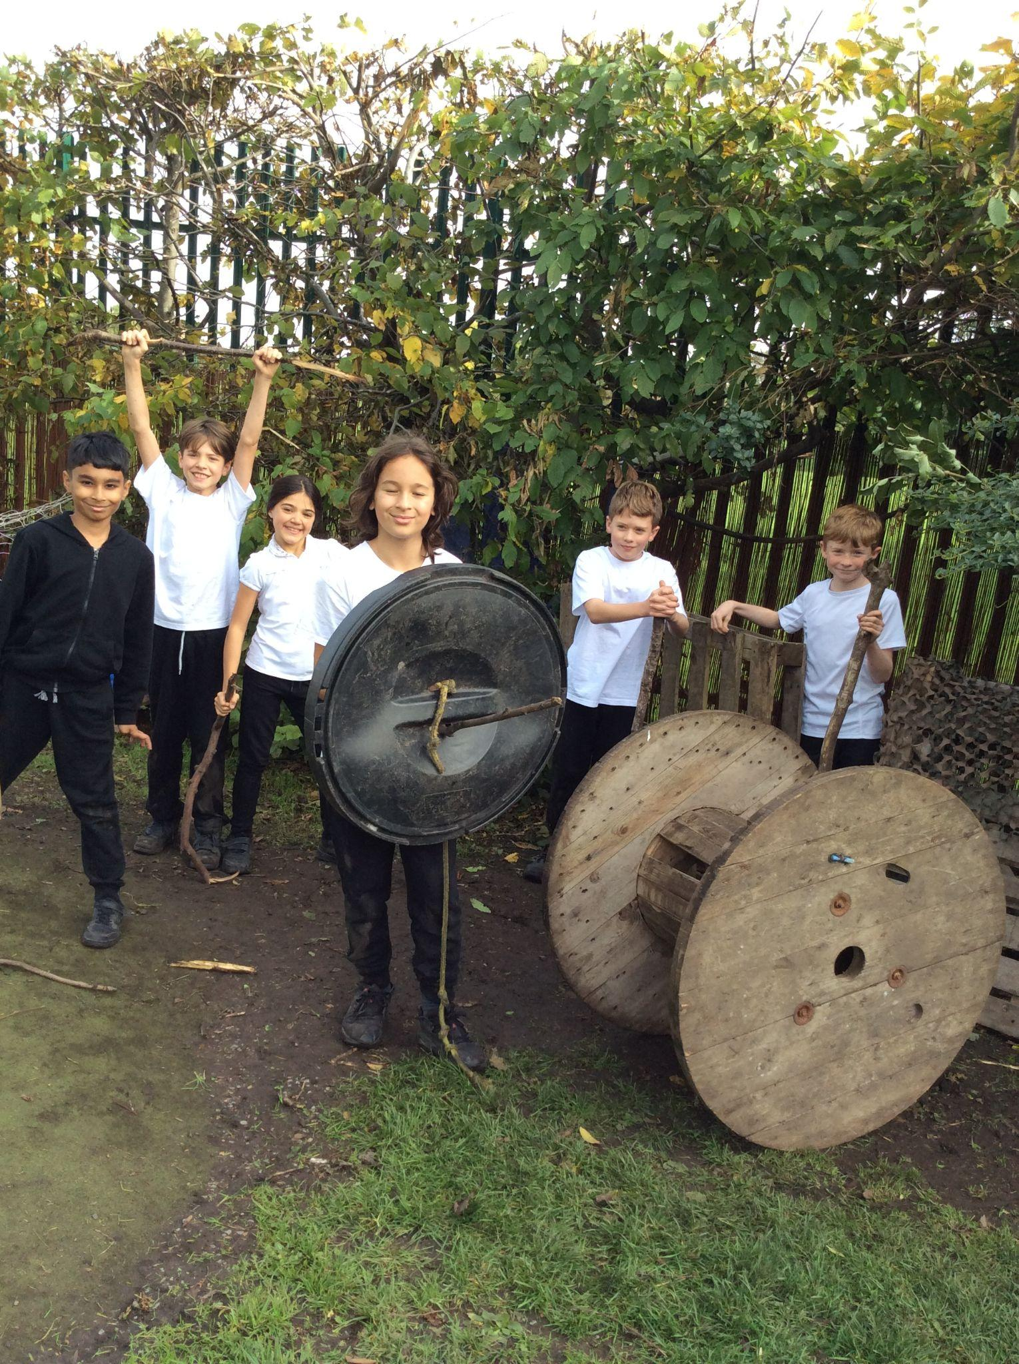
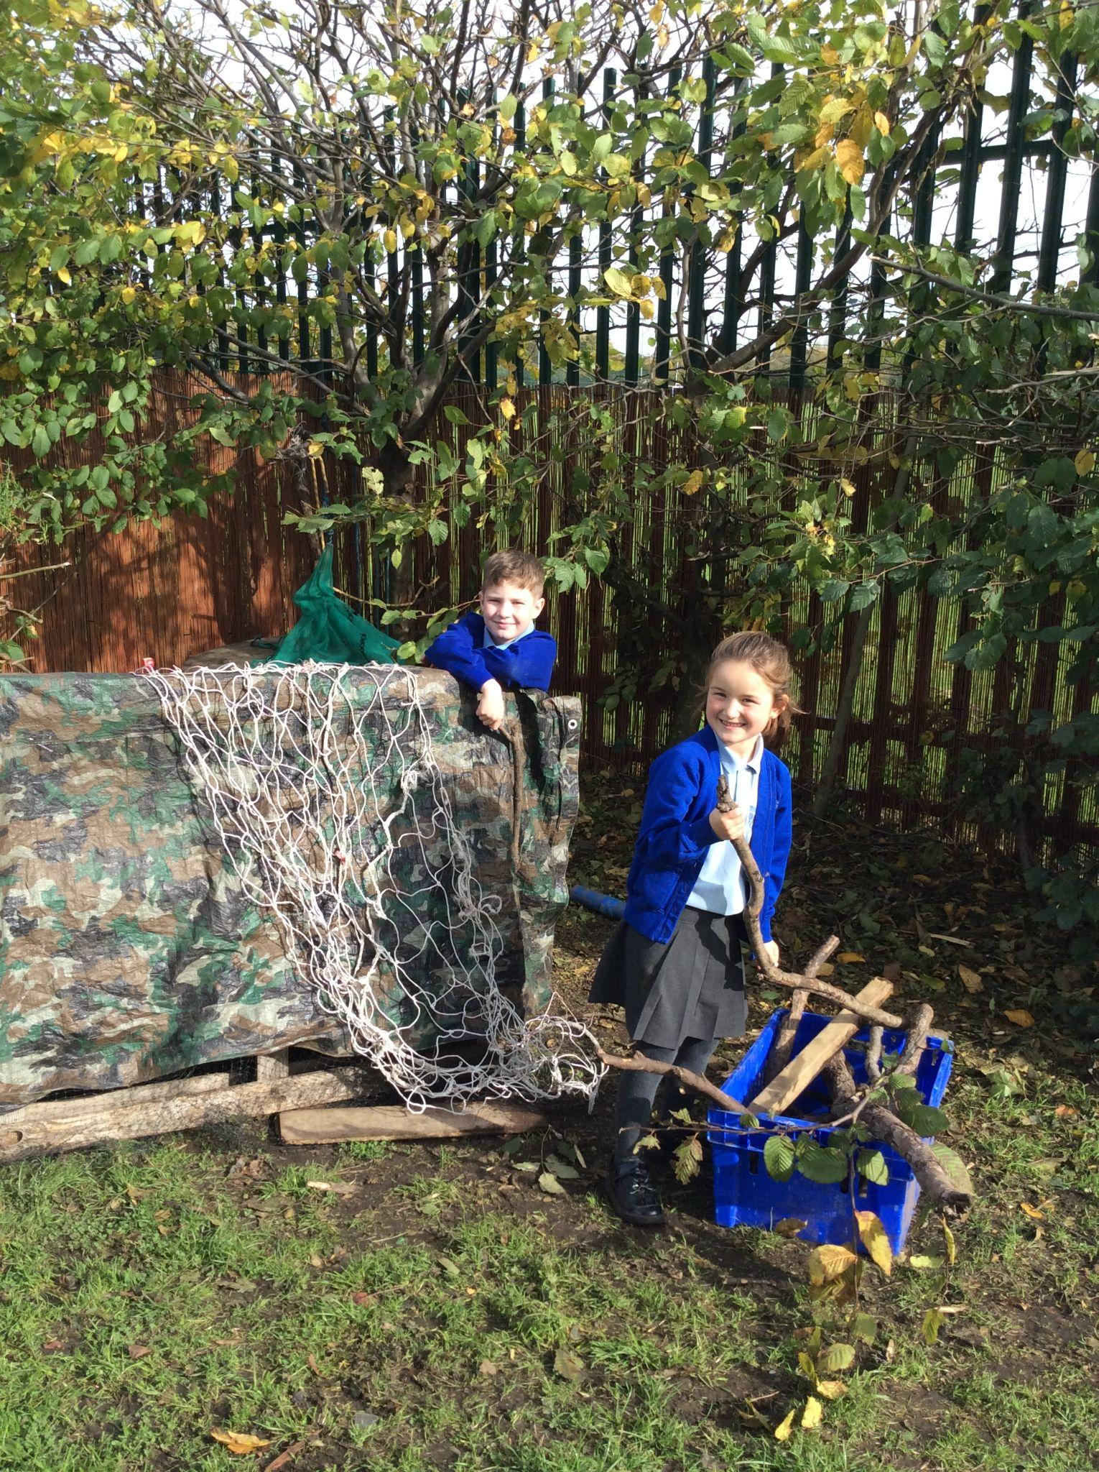
Den making area

Slide 4
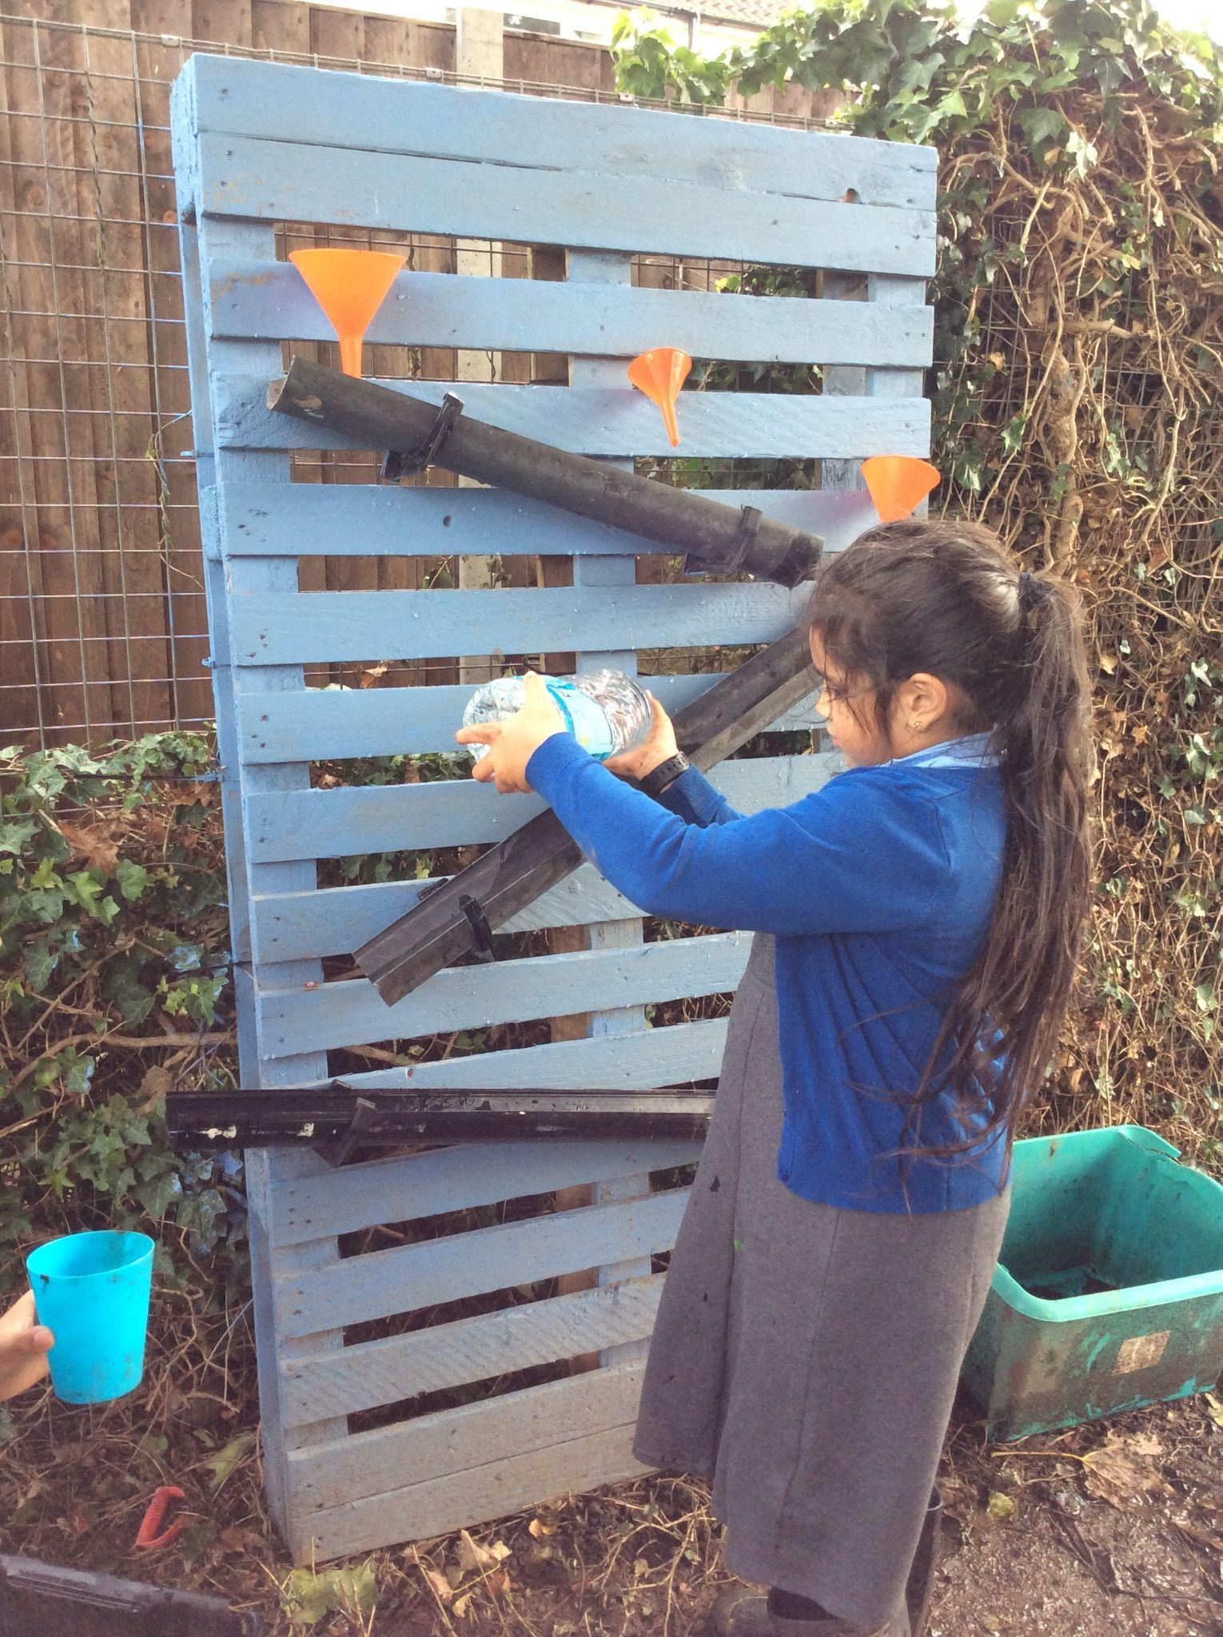
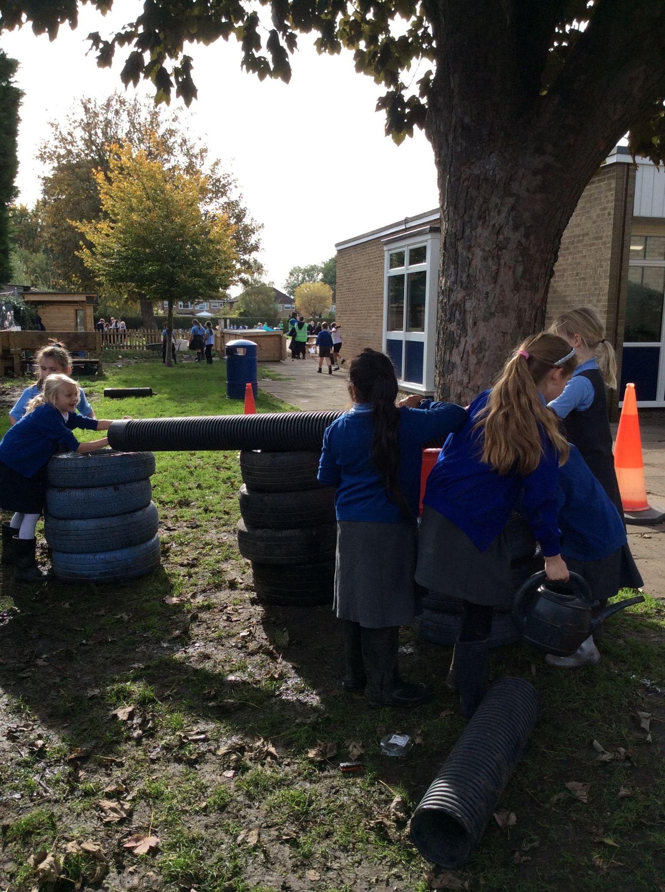

Water play area

Slide 5

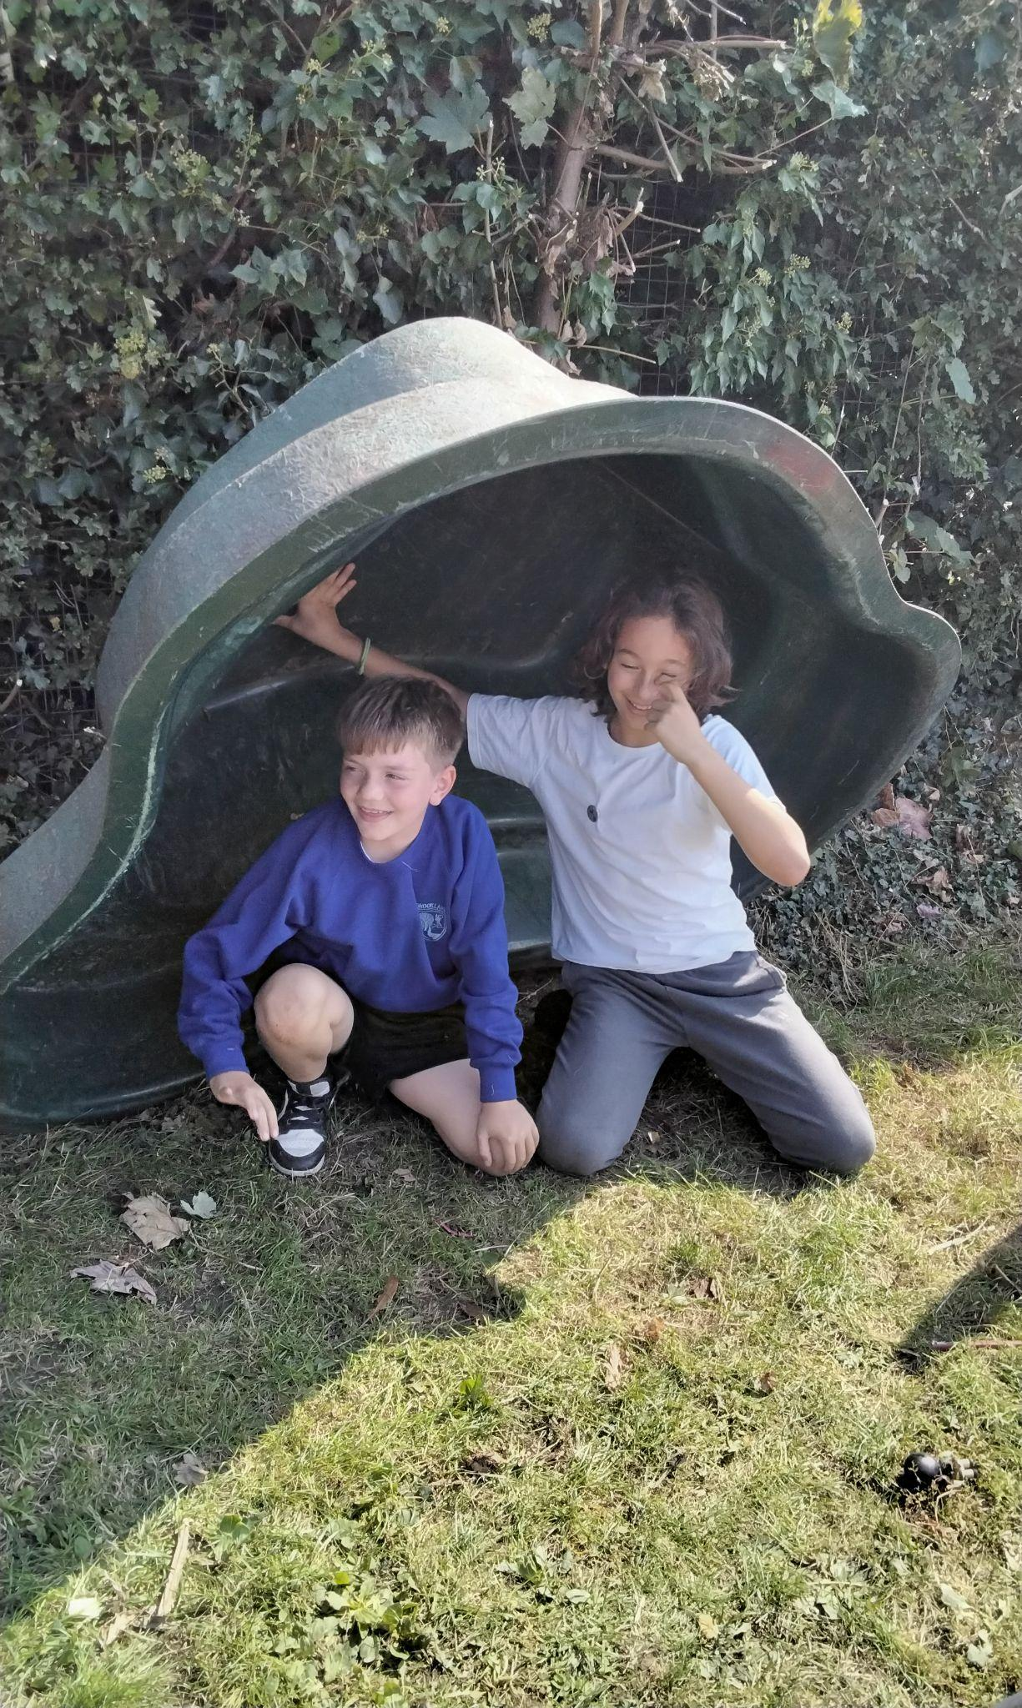
Green pond

Slide 6
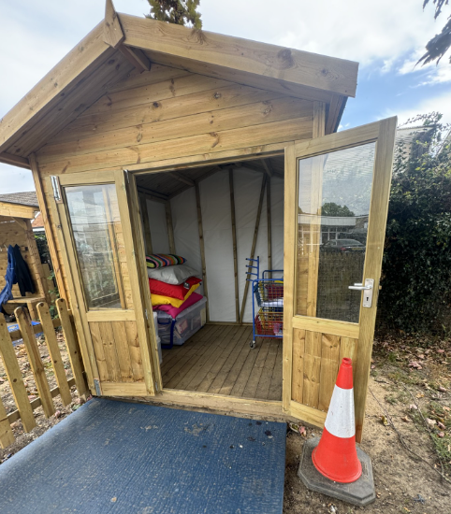
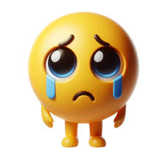
Unfortunately, our reading shed has been closed.
The door and window handles have both been broken.
Children have been jumping through the window.

Slide 7
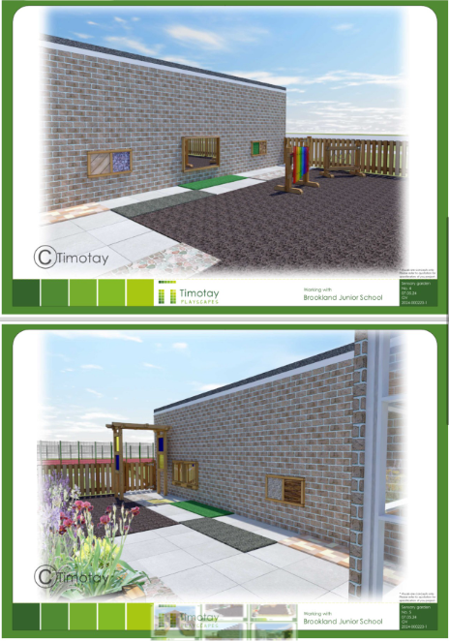
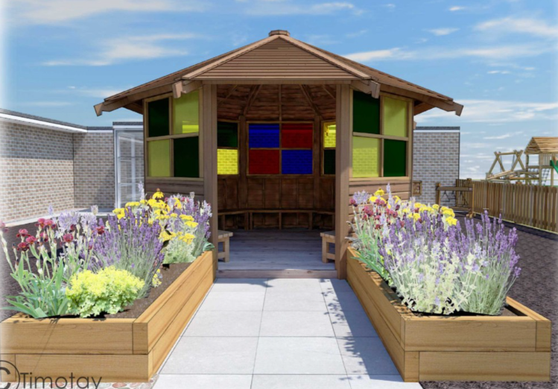
Ideas and plans for the gazebo renovation outside breakfast and after school club.

Slide 8
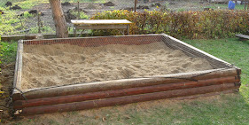
Moving forward
Sand pit
3 metres
6 metres

