Slide 1




Slide 2

Let's celebrate
A huge well done and thank you to ALL the children who have ensured that the OPAL equipment goes back to its correct home.

Slide 3

CHEXS are an incredible charity who work with young people in the community.
They often work on outdoor projects in the local area and schools.
Recently, CHEXS have generously built and donated our new water resource.

Slide 4
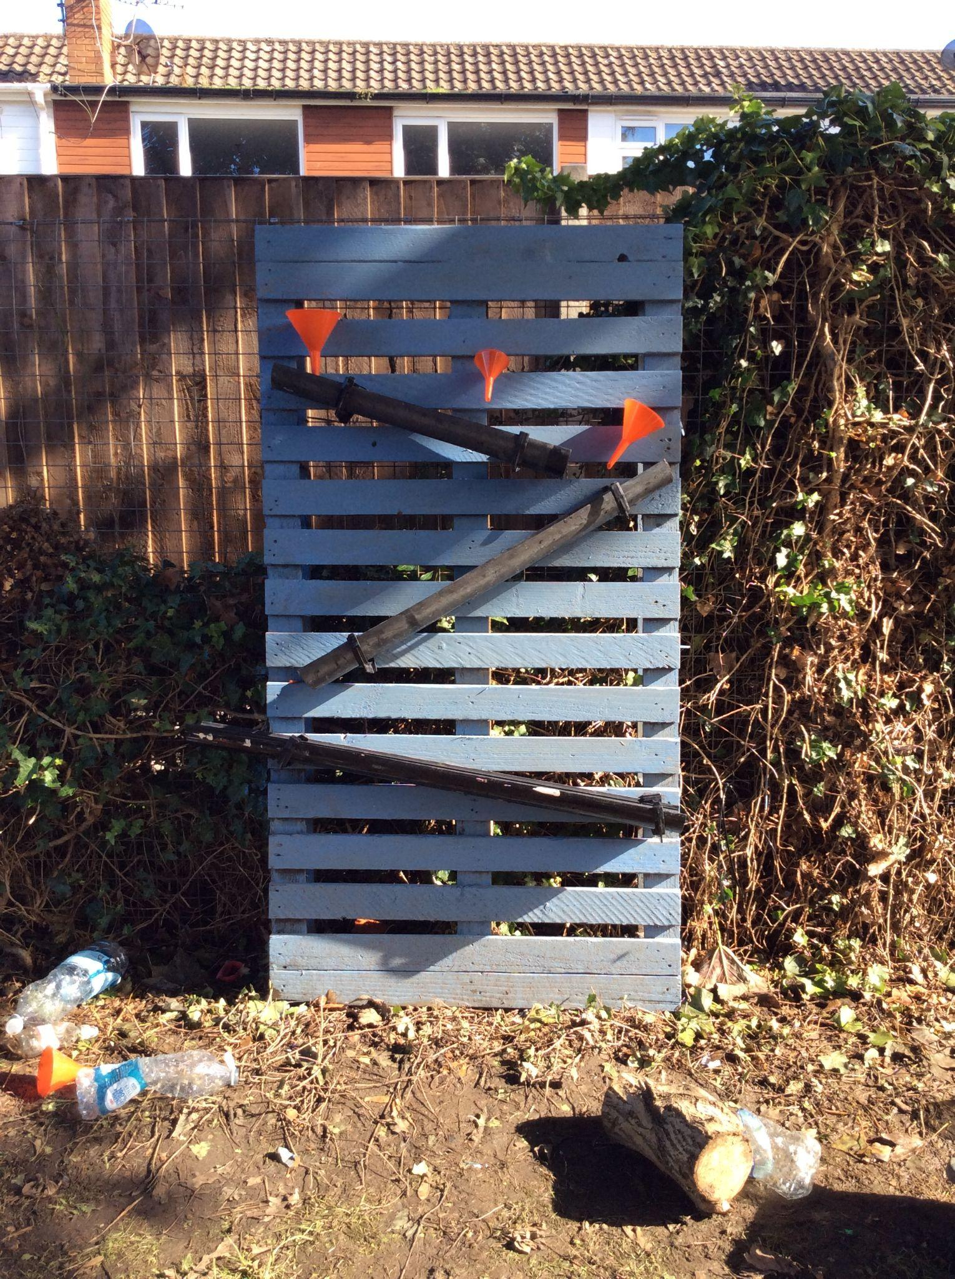
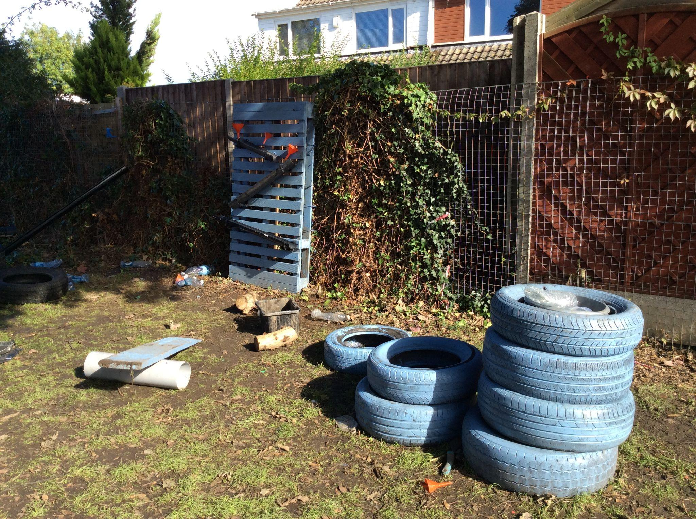

Slide 5

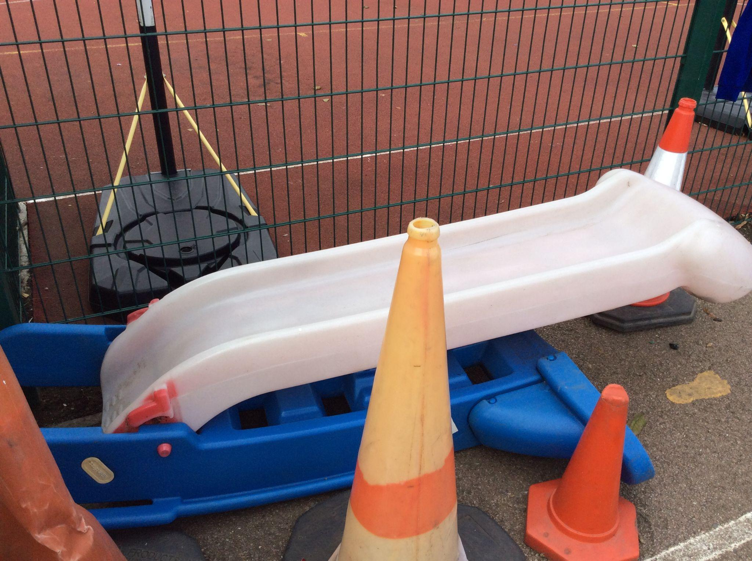
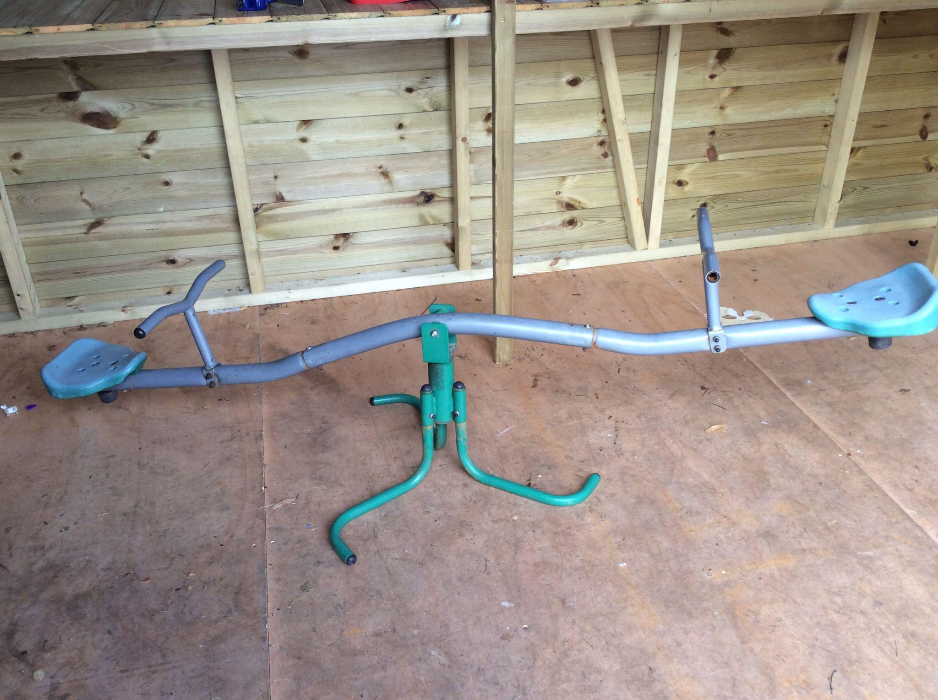
The slide
The seesaw

Slide 6
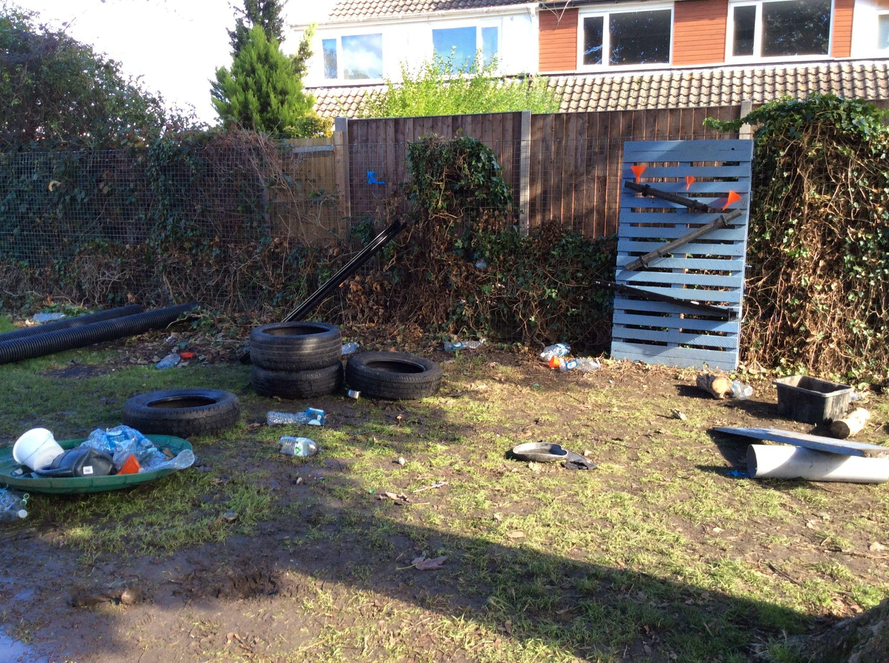
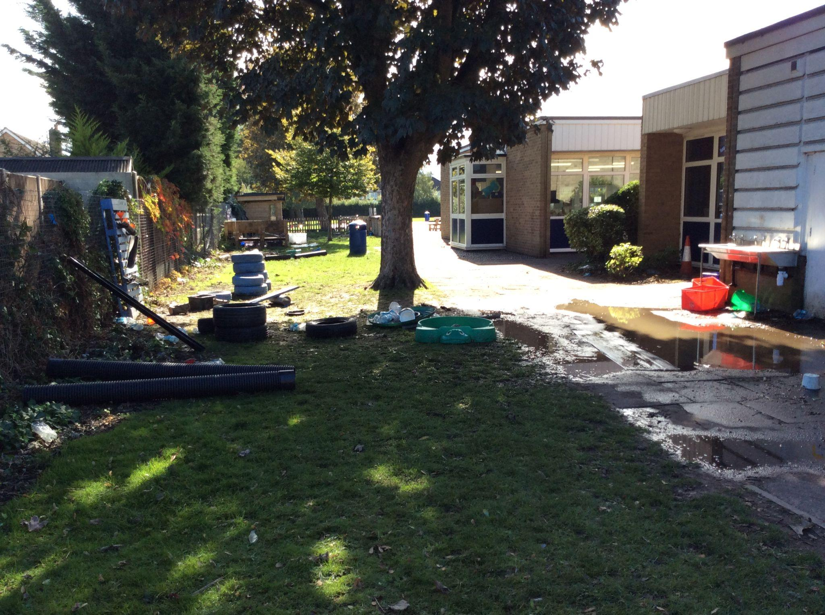

Slide 7
Expectations reminder
WALKING back to class and not running
RESPECT the equipment and each other
Be KIND
Make the RIGHT choice
We are a TEAM and so EVERYONE should be contributing to the tidying away of OPAL at the end of lunch

Slide 8

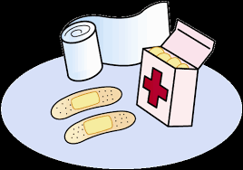
What is the time on the clock?
Where should we all be at this time?
Why is this important?
Notes:
We should not be taking ourselves to the medical room at 1:30pm if you have bumped yourself or fallen over earlier during your lunchtime.

Slide 9
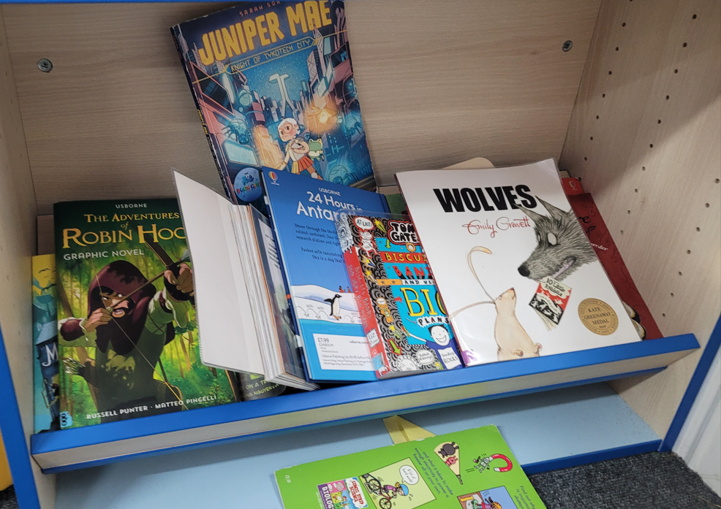
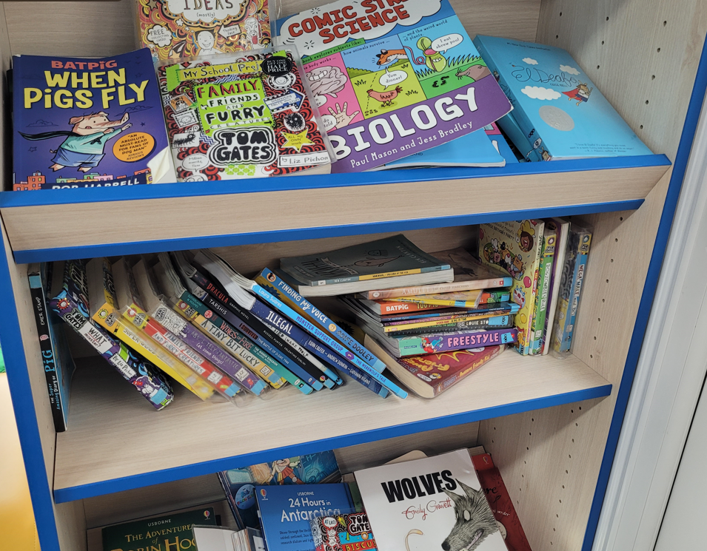

Our not so beautiful library

Slide 10


