Slide 1


What does that look like for us here at Brookland Juniors?

Slide 2

Article 12 - The right to have a view
Article 31 - The right to rest and play

Slide 3
Happier children
Children coming into class ready to learn
A fully inclusive playtime offer
It allows children an opportunity to be creative and make decisions
Children develop independence and resilience skills
Increased social skills
…. and most importantly fun!

Slide 4
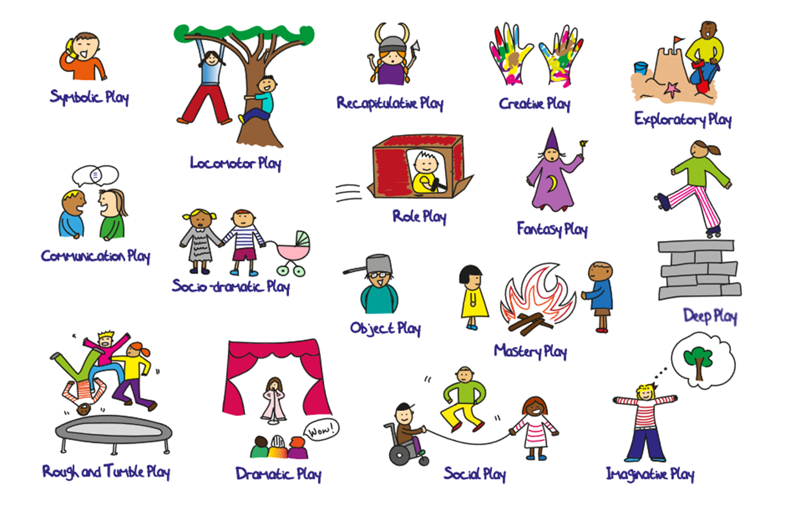
Let's celebrate

Slide 5
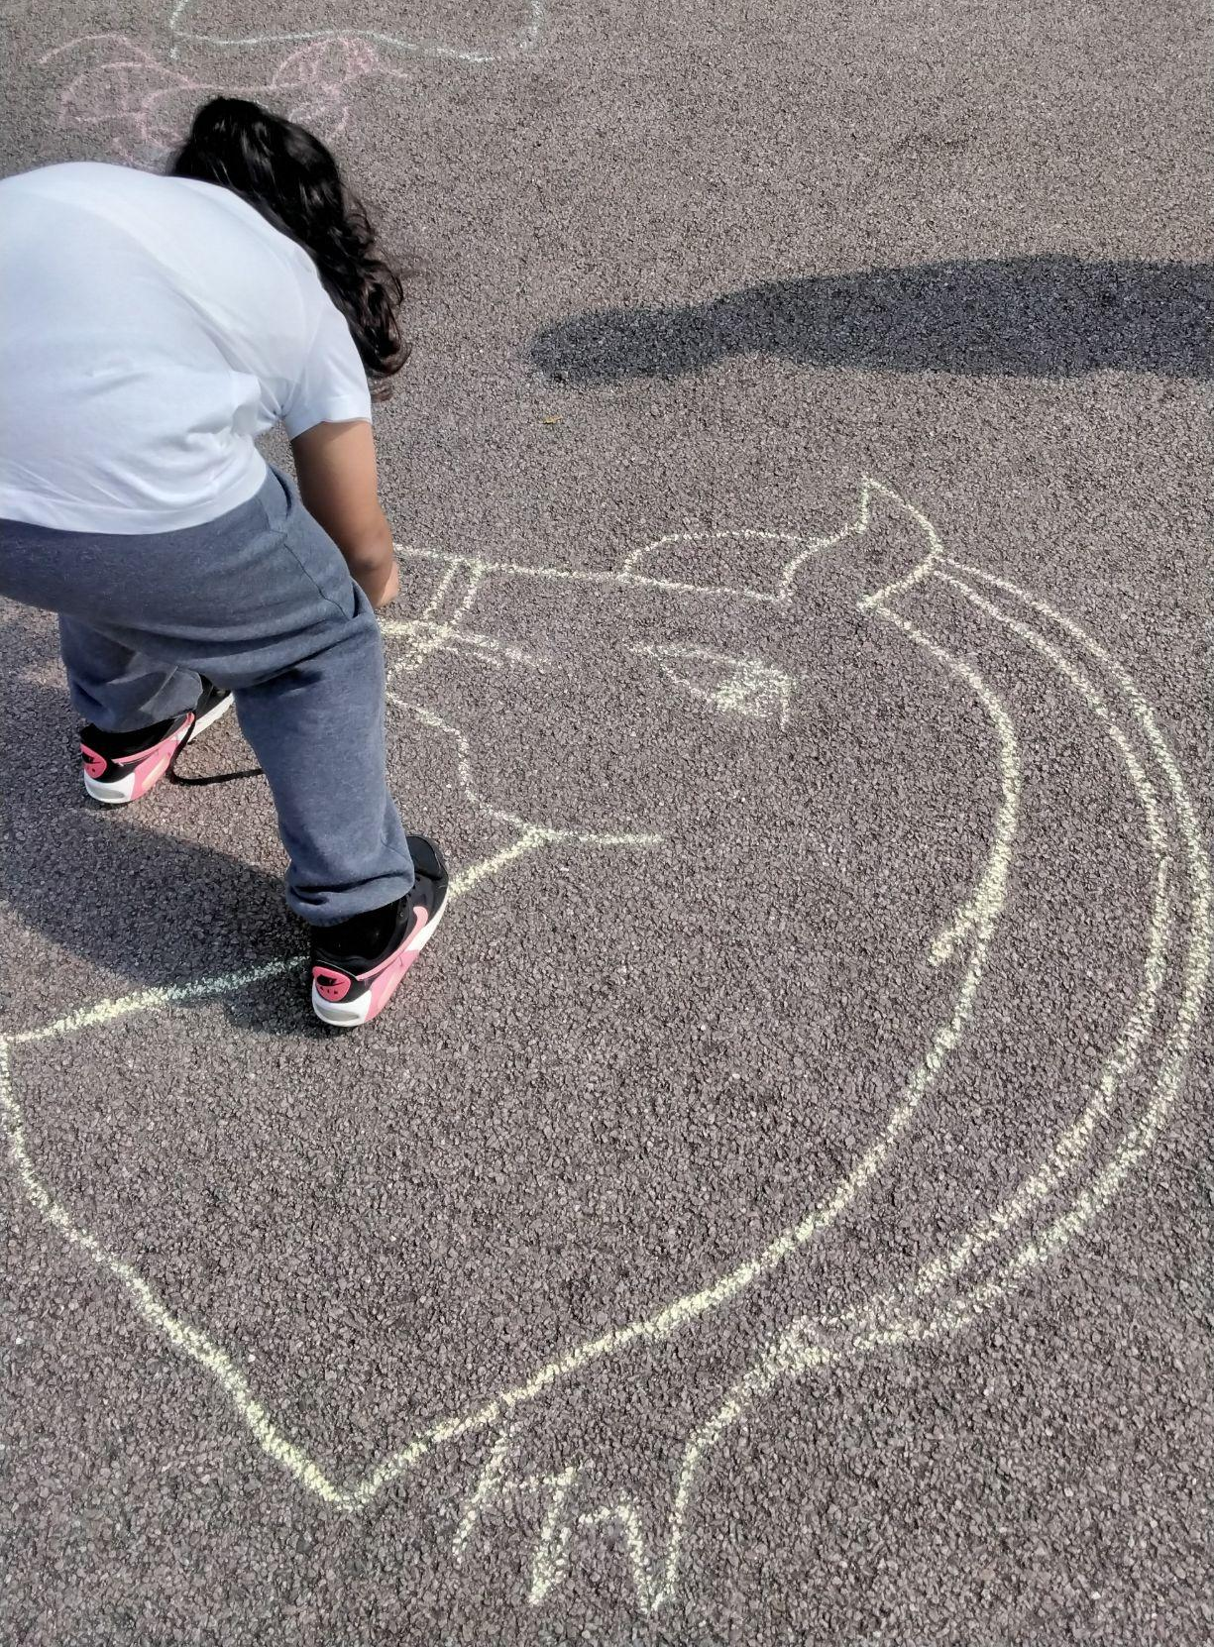

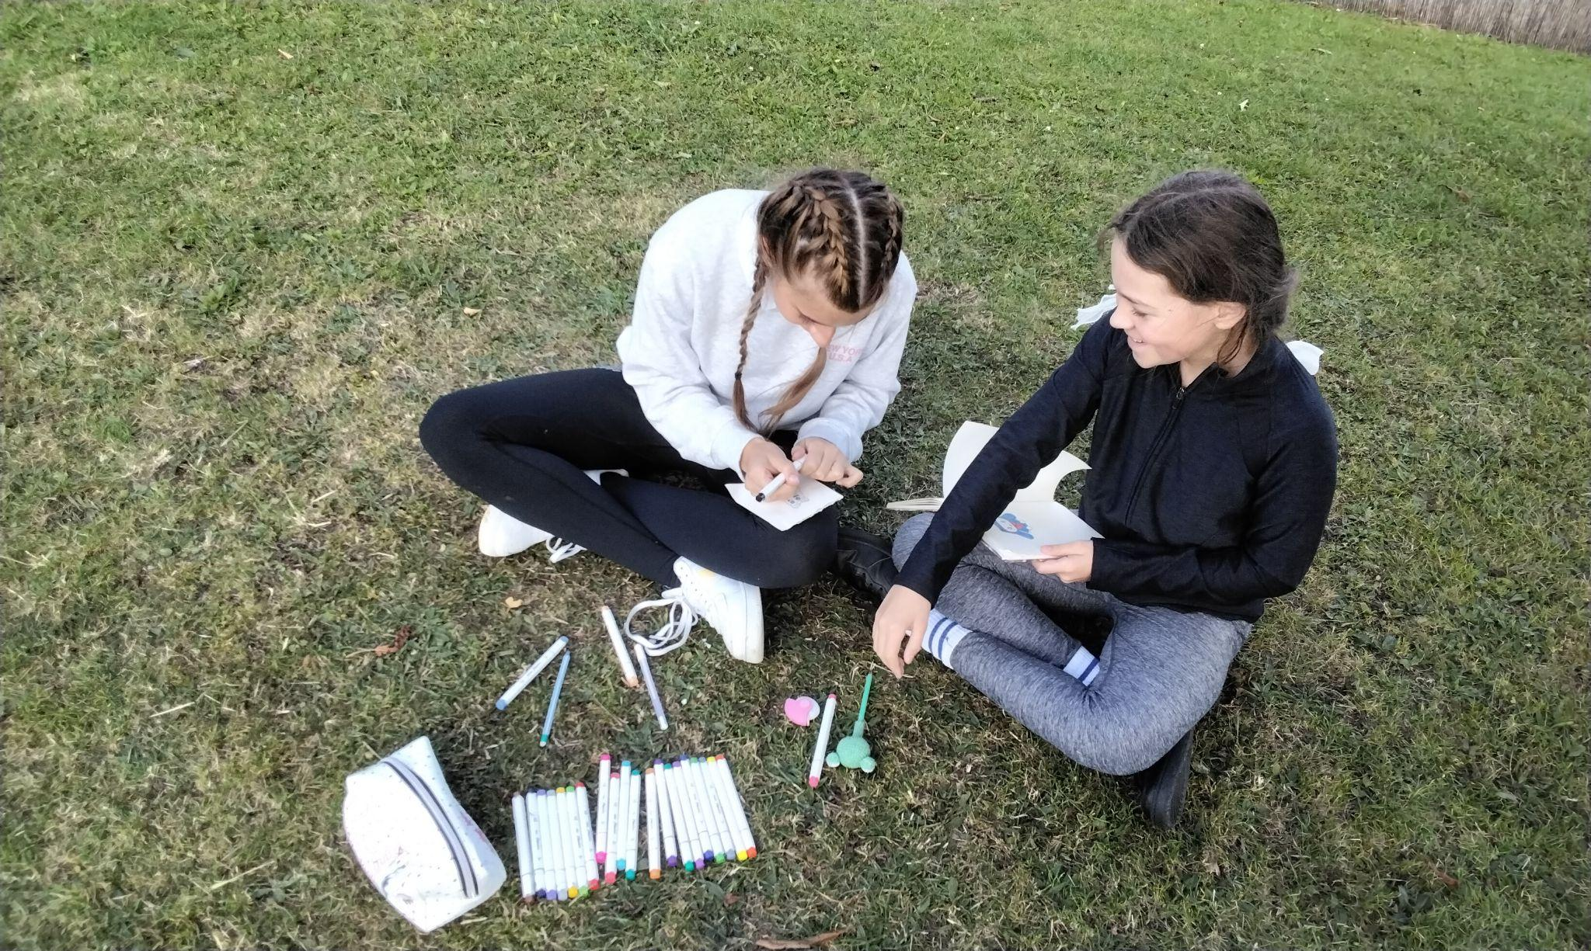

Slide 6
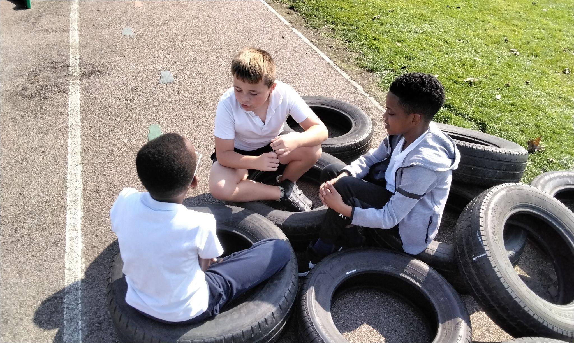


Slide 7

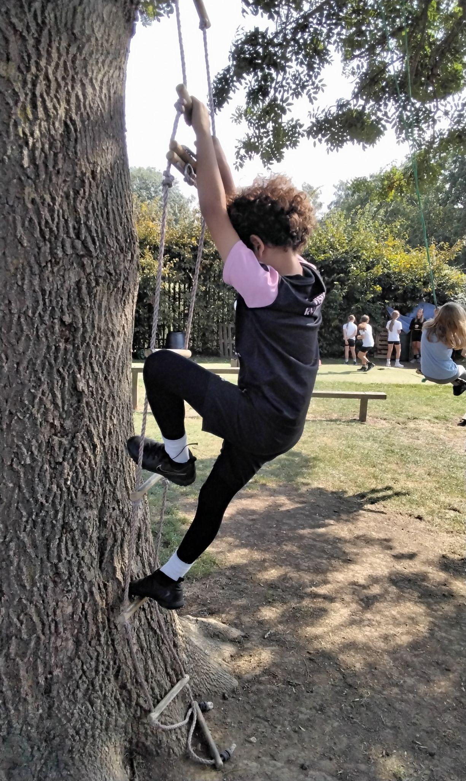
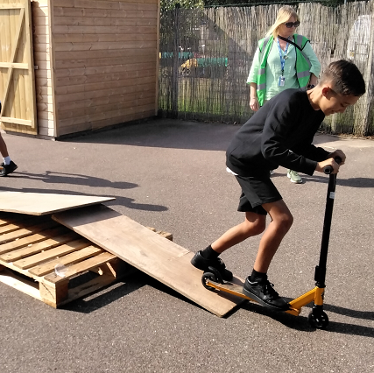

Slide 8
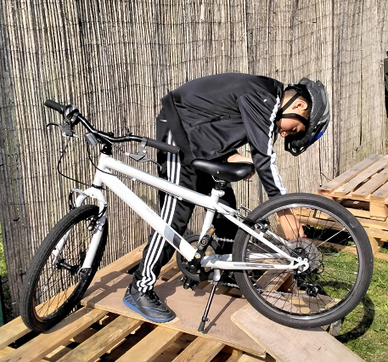
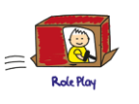

Slide 9
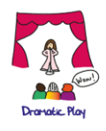
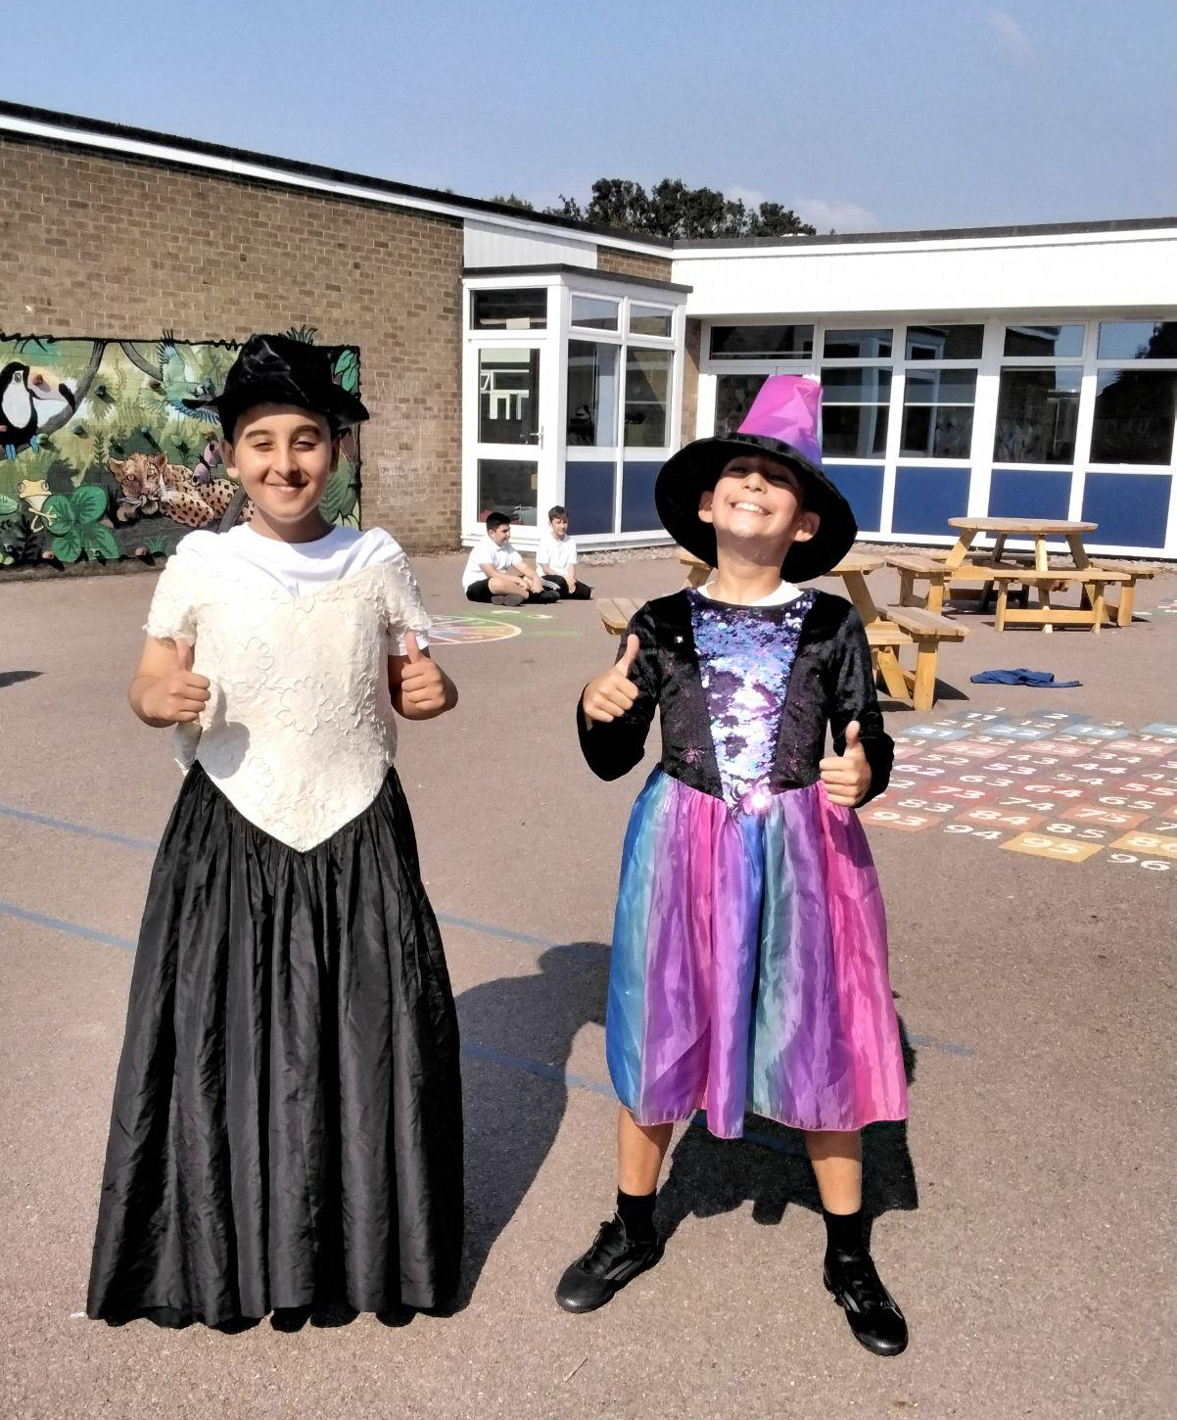
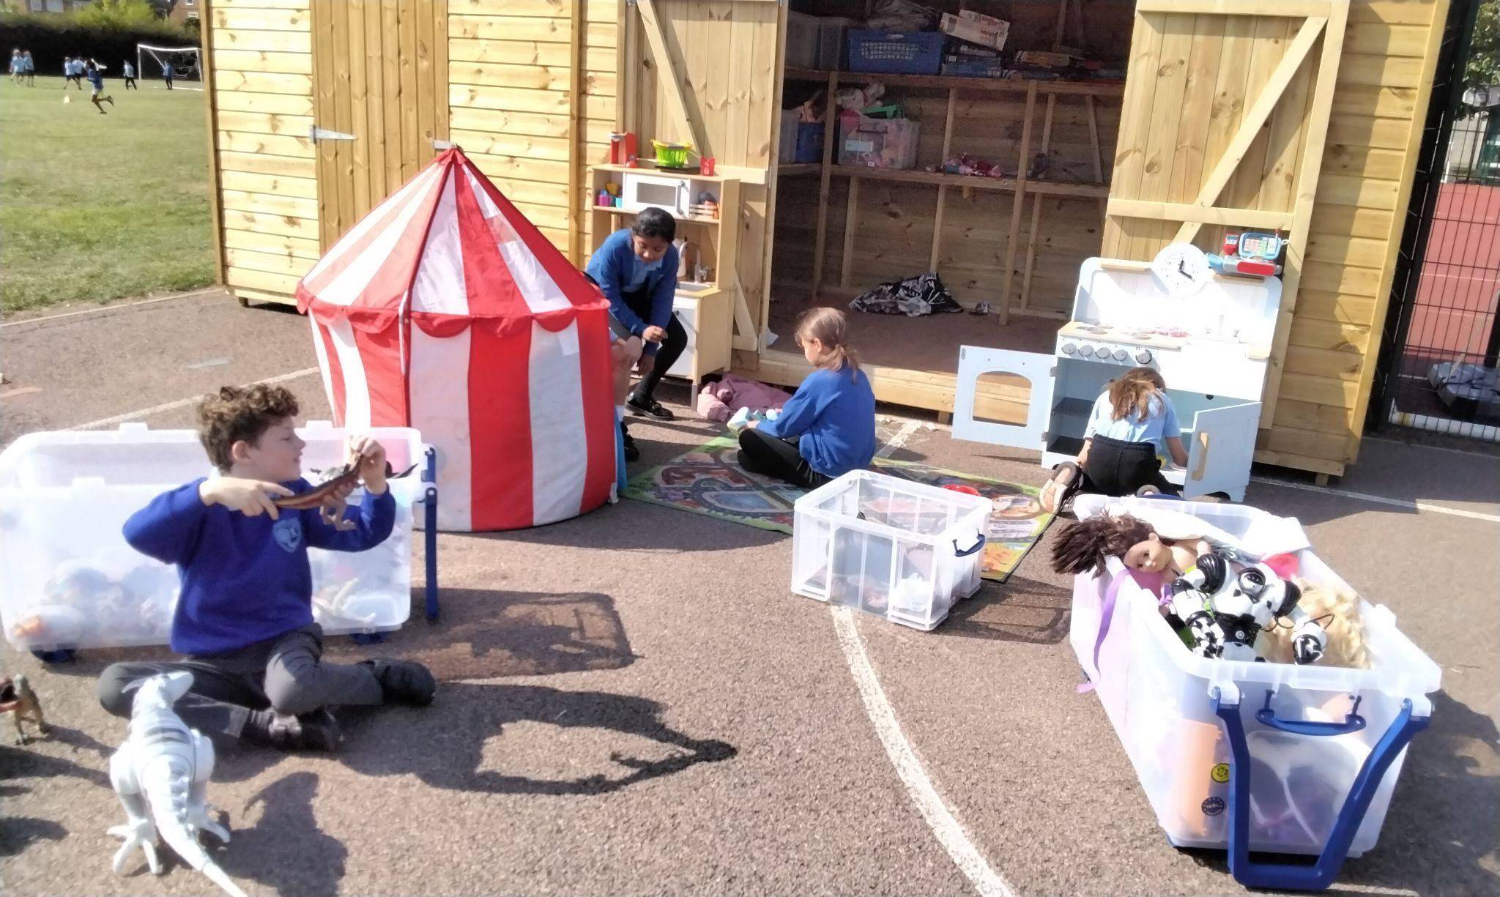

Slide 10
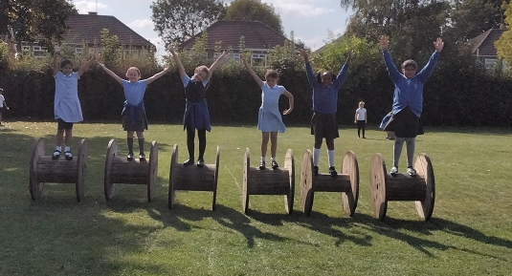



Slide 11
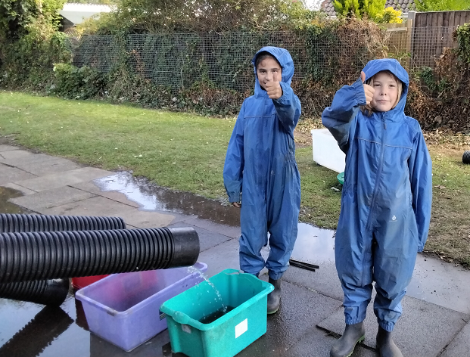
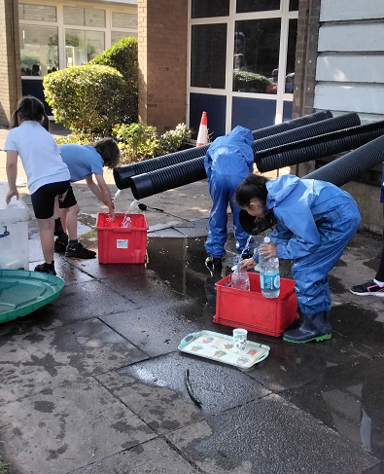

Slide 12
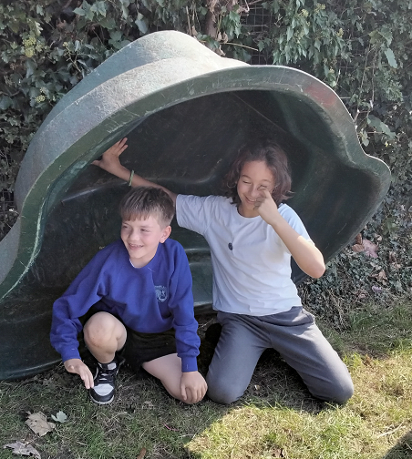
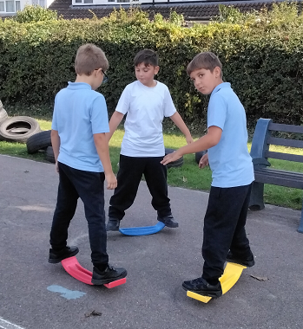

Slide 13
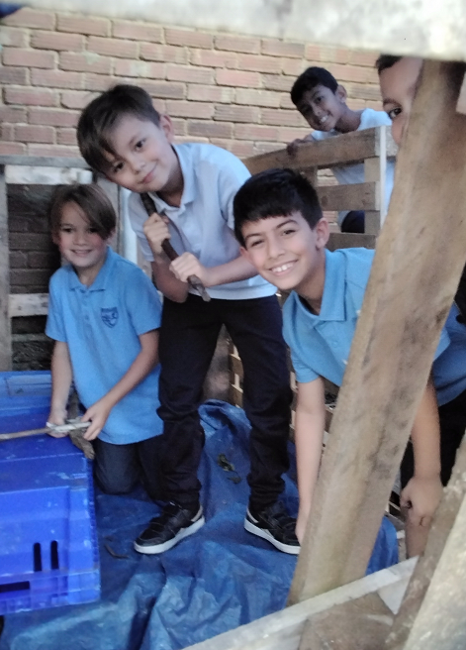
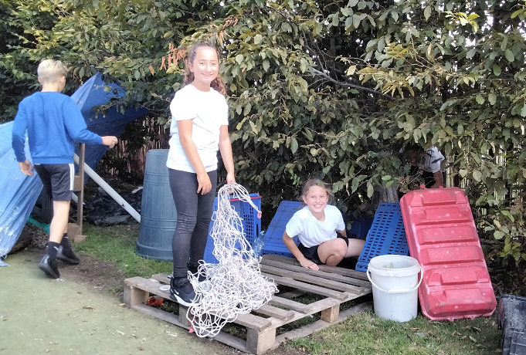

Slide 14
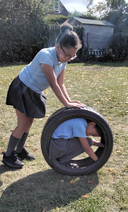
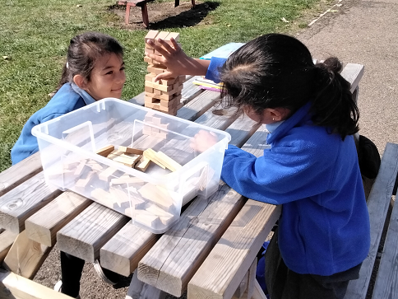

Slide 15
Expectations
WALKING back to class and not running
RESPECT the equipment and each other
Be KIND
Make the RIGHT choice
We are a TEAM and so EVERYONE should be contributing to the tidying away of OPAL at the end of lunch

Slide 16
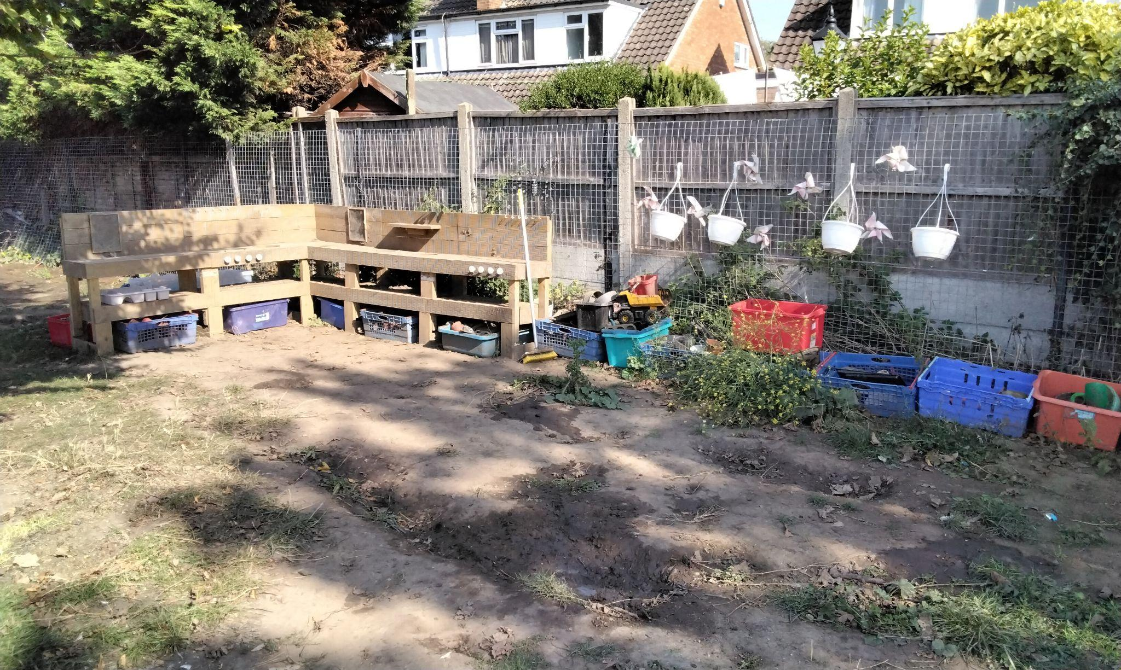
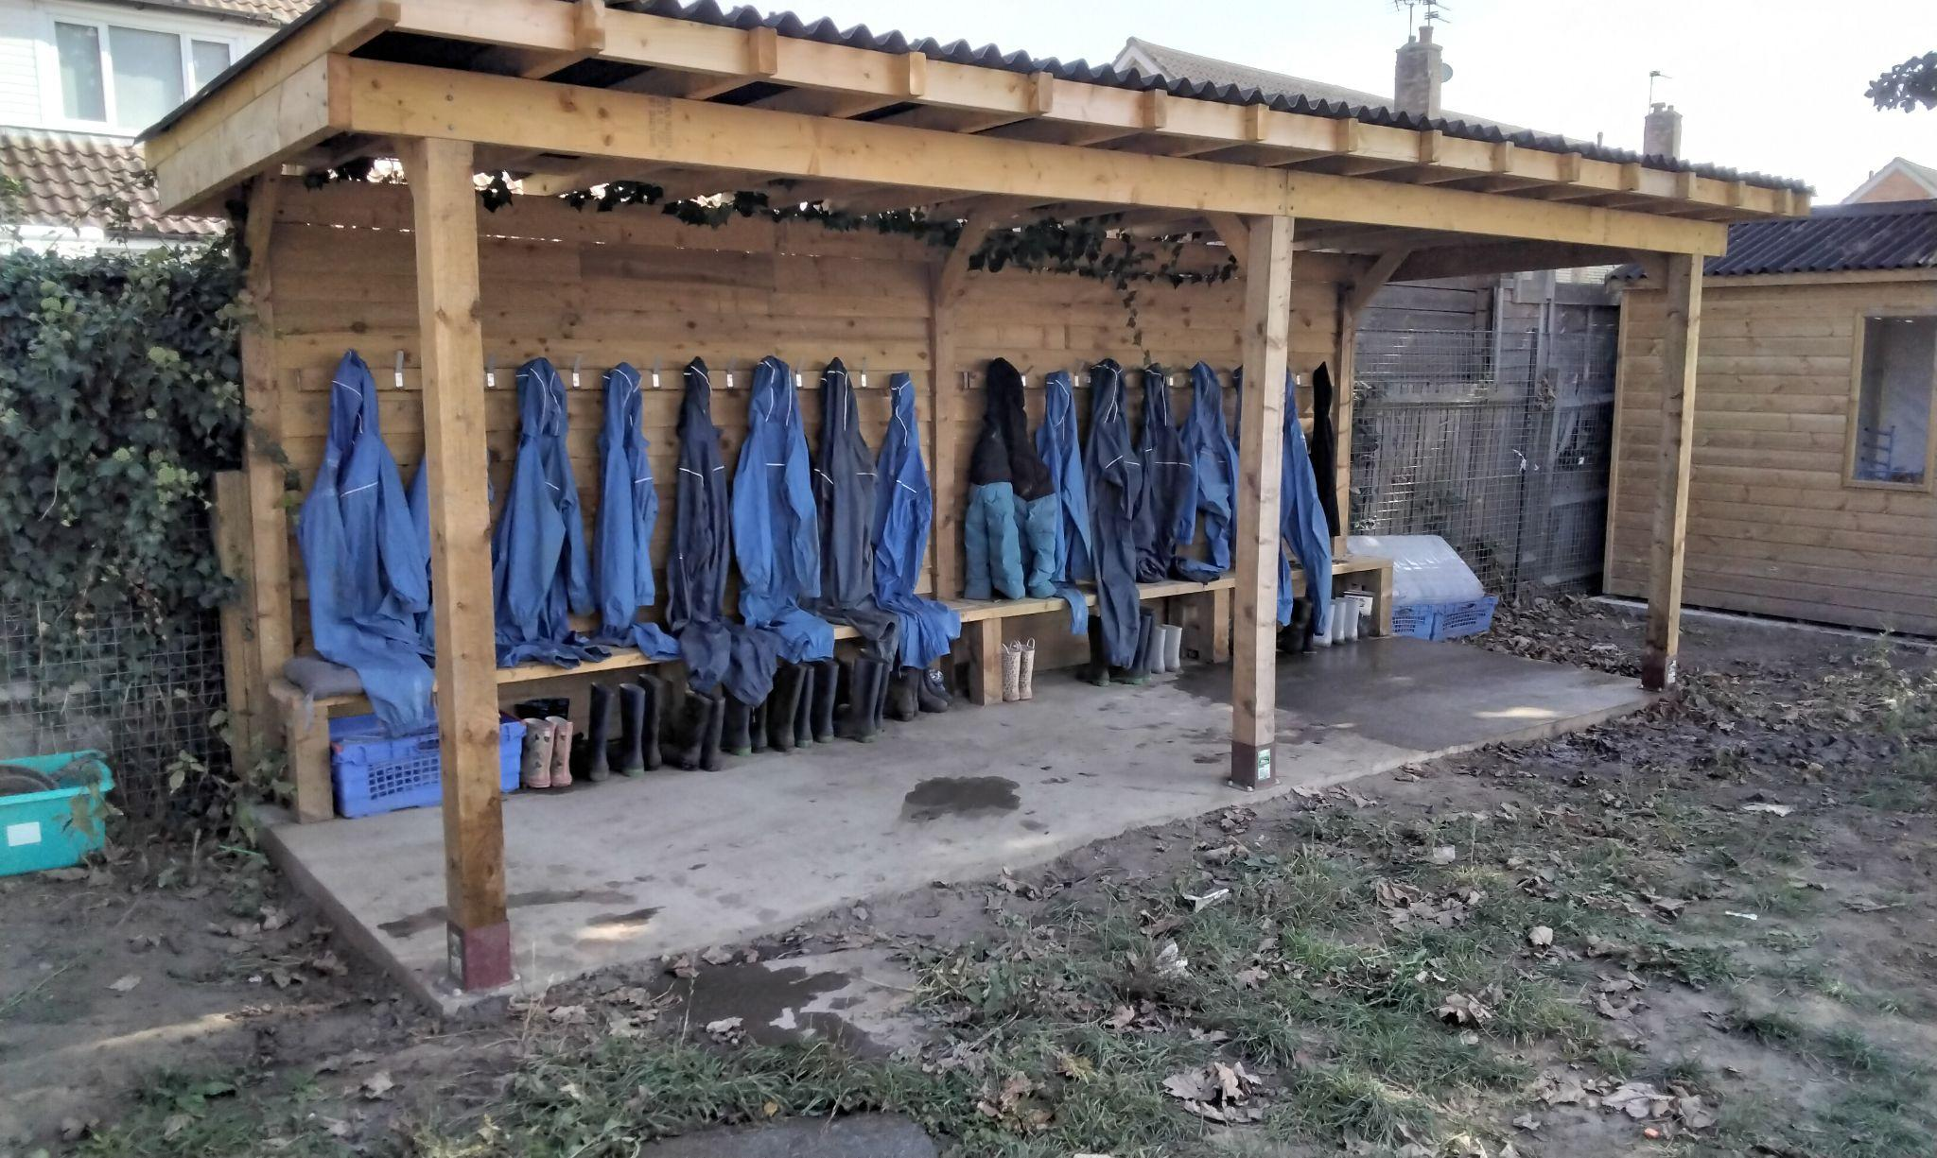

Slide 17
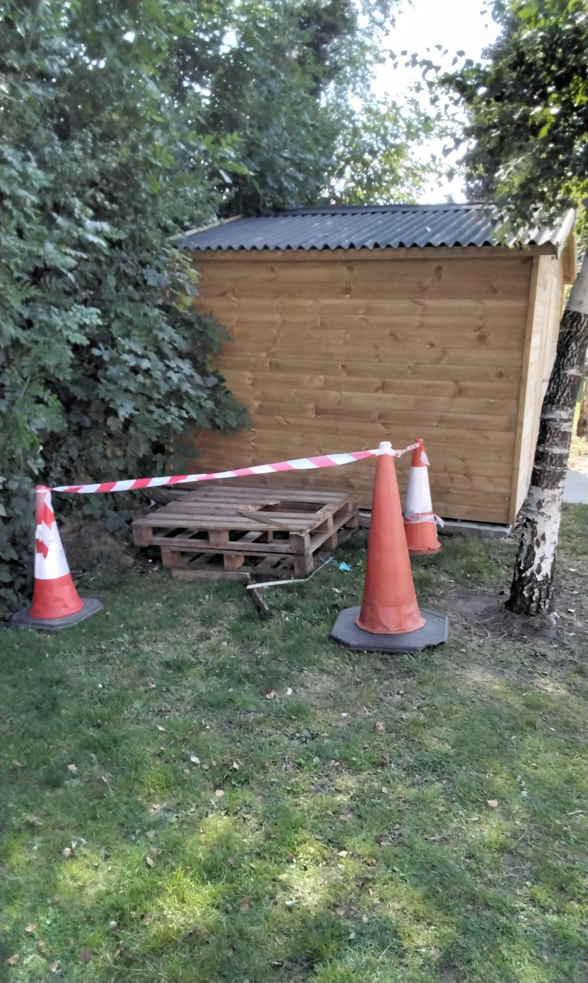
What do we think these cones and tape might indicate?
Where can we find this area?
Who is allowed to access this area?

Slide 18
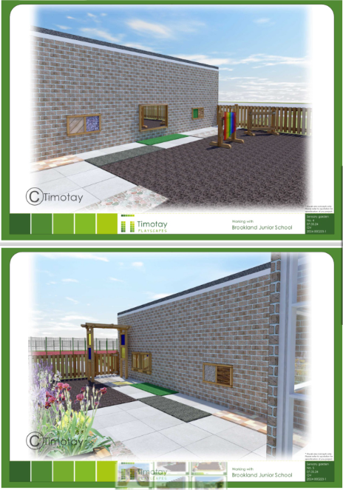
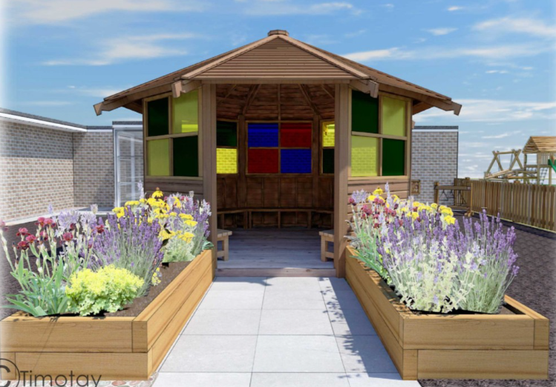
October half term

