Slide 1


What do we already know about OPAL?
What does OPAL stand for?

Slide 2
Let's celebrate
Over the summer we have been fortunate enough to have received a great deal of donations from Brookland friends and family.
We have a new OPAL/PE shed on the playground and soon we will be transforming the gazebo to a calm sensory area.

Slide 3
Let's remind ourselves of some of the
OPAL ranges across the school

Slide 4
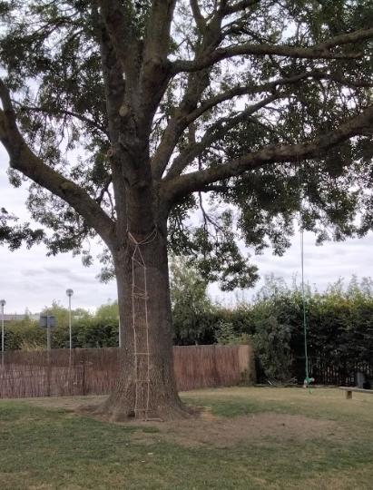
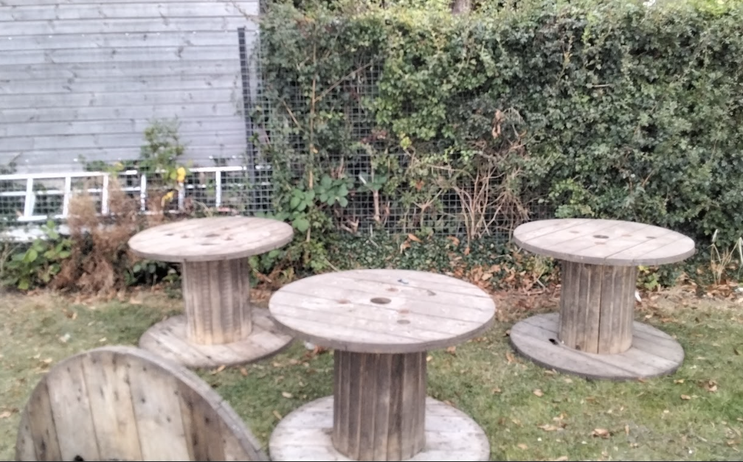
Tree swings and ladders on the hill outside Birch Class.
Think about some of the rules and expectations when playing in these ranges.
Large reels on the field.

Slide 5
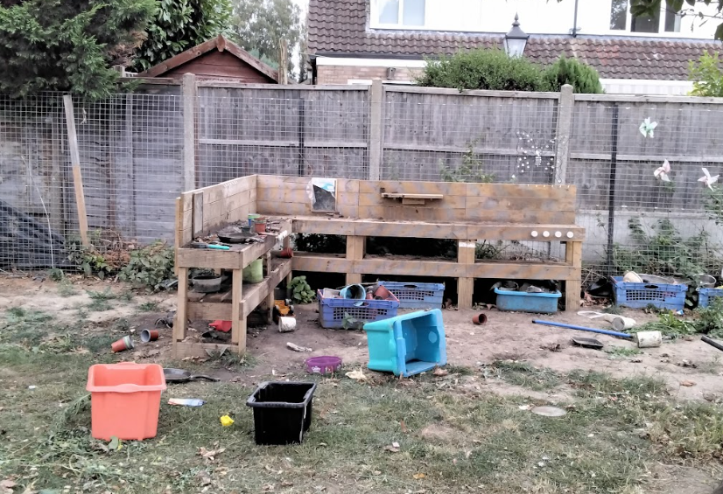
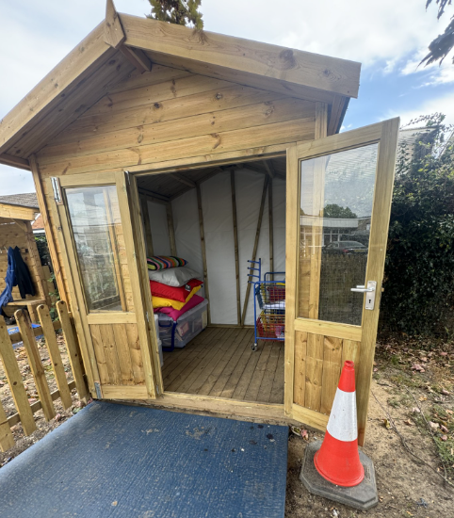
Mud kitchen next to the reading shed.
What is wrong with how the mud kitchen has been left?
What do you notice about the reading shed?
Reading shed

Slide 6
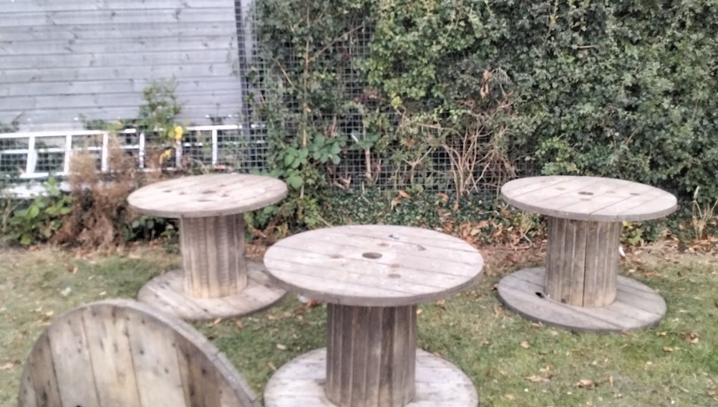
Large wooden reels on the field.
What are the rules when using these large wheels?
How can we use these?
Where can we use them?

Slide 7
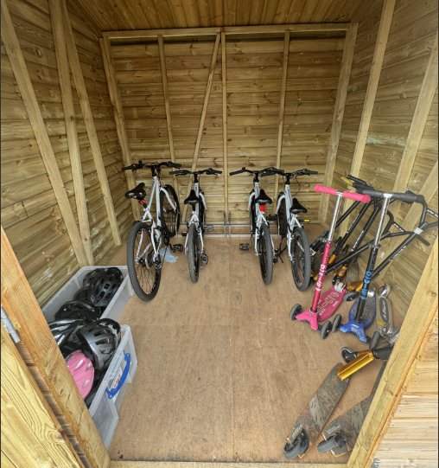
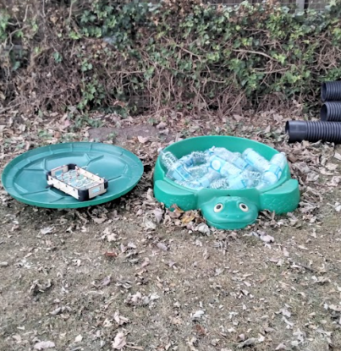
Water play opposite the outside sink.
How should these areas be left?
Wheeled area (bikes and scooters) on the small playground.

Slide 8
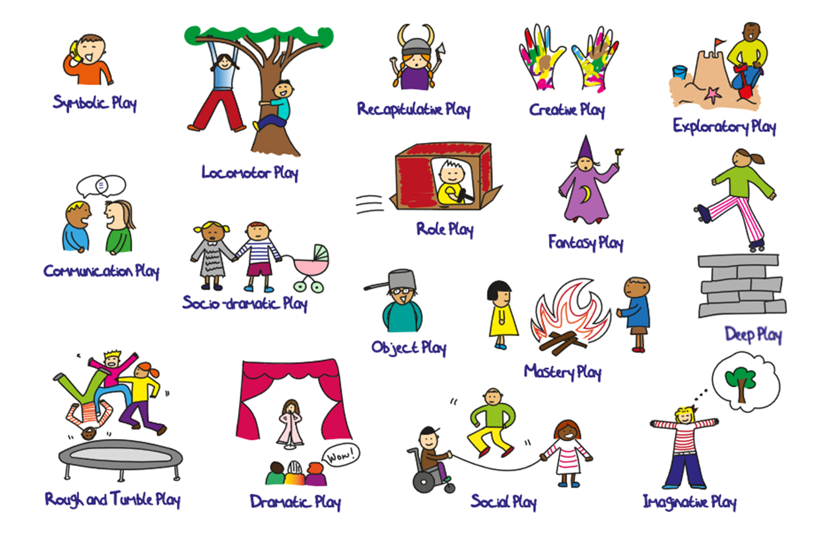
Different ways of playing within our OPAL ranges

Slide 9
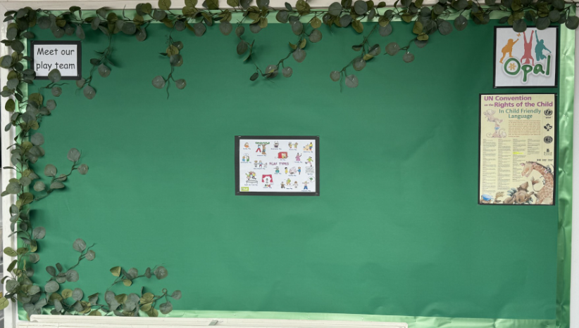
Keep an eye out for our OPAL display outside Mrs Barton’s office.
We will be updating this throughout the year.
In our next assembly, we will be discussing the OPAL charter and what that looks like for us at Brookland Juniors.

Slide 10
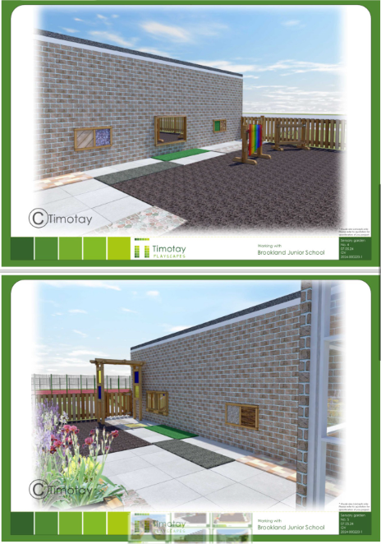
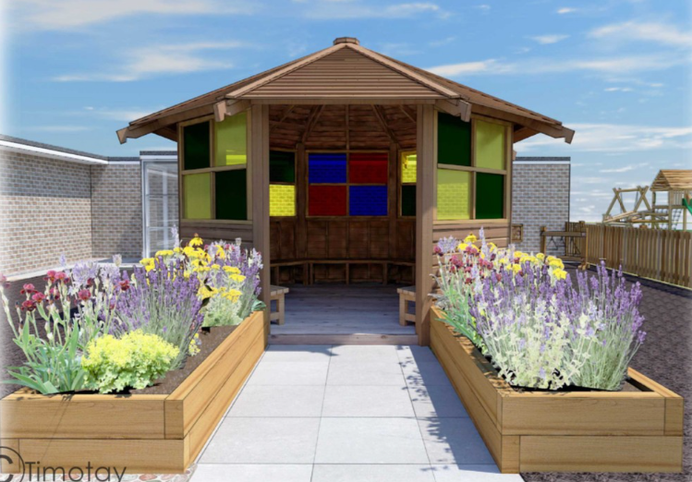
Ideas and plans for the gazebo renovation outside breakfast and after school club.

