Slide 1

BROOKLAND FEDERATION
Brookland Junior School
‘Kind, Respectful, Best’
Year 6 Meet the teacher

Slide 2

Welcome to Year 6
Thank you very much for attending
We are all really looking forward to working in partnership with you and teaching our wonderful Year 6 children.
This presentation will give you some key information about Year 6.

Slide 3



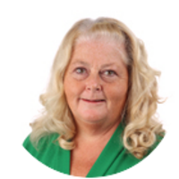
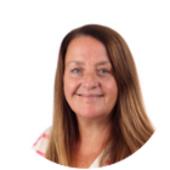
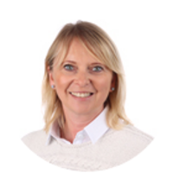
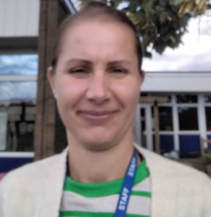
Meet the Year 6 Team
Miss Harrison
Birch Class Teacher
Mr Kaal
Redwood Class Teacher
Mr Waller
Willow Class Teacher
Mrs Clark
Teaching Assistant
Mrs Curry
Teaching Assistant
Miss Page
Teaching Assistant
Mrs Tsourou
Learning Support Assistant

Slide 4
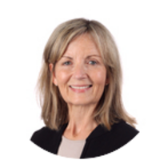


Meet the Year 6
PPA Team
  Mrs Coombs
Mr Cawley
Mrs Moore
Our PPA time will be every Thursday morning.
Notes:
OW

Slide 5
The Brookland Values
Be KIND
Be RESPECTFUL
Be the BEST that you can be
Notes:
OW

Slide 6

Rights Respecting school
Each class has a Class Agreement based on the Unicef Rights of the Child.
The class chooses the rights to focus on such as the right to an education, the right to be safe, the right to relax and play.
We have a weekly session where children learn more about the rights and how they can help everyone to receive their rights.
Notes:
MK

Slide 7


We are INCLUSIVE and DIVERSE
The children are at the centre of everything we do
We treat each child as an individual
We acknowledge diversity because we are diverse
We are working on ensuring our curriculum continues to be diverse
We will be using aspects from the ‘No Outsiders: Everyone different, everyone welcome’ scheme which uses children’s literature and real-life news stories to discuss differences and acceptance.
Notes:
MK

Slide 8
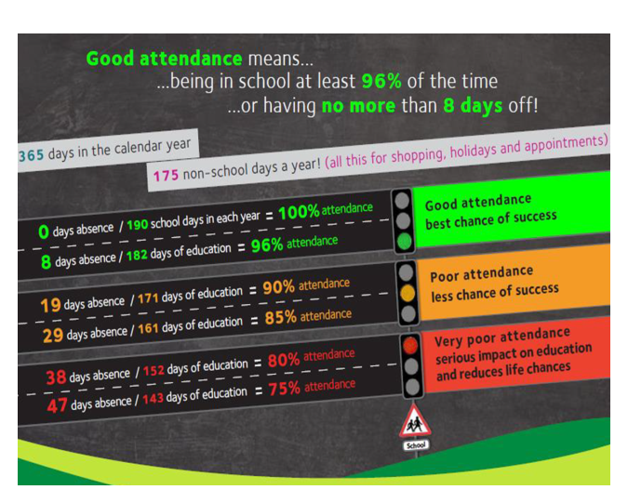
ATTENDANCE MATTERS
We can not stress enough how important it is that your child attends school everyday
We know children get ill, but unless they are really poorly please send them in. Please do not keep them at home for a runny nose, a slight cough etc.
Speak to the office and depending on the circumstances, we are happy to administer calpol or nurofen if needed
Term time holidays will not be authorized
Attendance Policy has further details
Notes:
SH

Slide 9
Uniform
We have very high expectations and this starts with uniform.
Please ensure your child comes to school in correct school uniform and PE uniform.
Uniform lists have been previously emailed out and are available on our school website.
No jewelry – except stud earrings, a watch (not SMART), and any jewelry worn for religious reasons – NO bracelets, bangles, rings, nail polish, make up etc. Dark coloured school shoes to be worn on non-PE days.
PE uniform – NO football kits, hoodies or bright trainers. Children can wear their school jumper over their PE uniform.
We recommend your child bringing in a pair of wellies that they keep at school - they will be used for our outdoor lunchtime provision.
We do have coveralls for the children to wear, however, if your child is likely to be fond of water and mud, it may also be useful to put some spare clothing in their school bag.
Notes:
SH

Slide 10
Equipment
School bag
Water bottle – named - only water
Stationery – we provide everything your child needs but they are welcome to bring in their own stationery – but no big ‘smiggle’ type pencil cases please
No toys to school
cards are not to be traded.
Year 6 children should not bring in a mobile phone, unless they walk home alone
Notes:
OW

Slide 11
Curriculum
We teach a broad and balanced curriculum covering all areas of the National Curriculum.
In Year 6, we teach 7 maths lessons a week and 10 English lessons over 2 weeks. Guided Reading is taught 4 times a week. Spelling and handwriting are taught separately.
There are 2 PE lessons a week – Wednesday and Thursday
Your child will also have weekly lessons in Science, RE, PSHE, Music, Computing, History/Geography, Spanish, Art/DT
Your child may have ‘intervention’ sessions to help them catch up or to give extra support. These are small group or individual sessions, which usually take place in the afternoon.
Notes:
OW

Slide 12
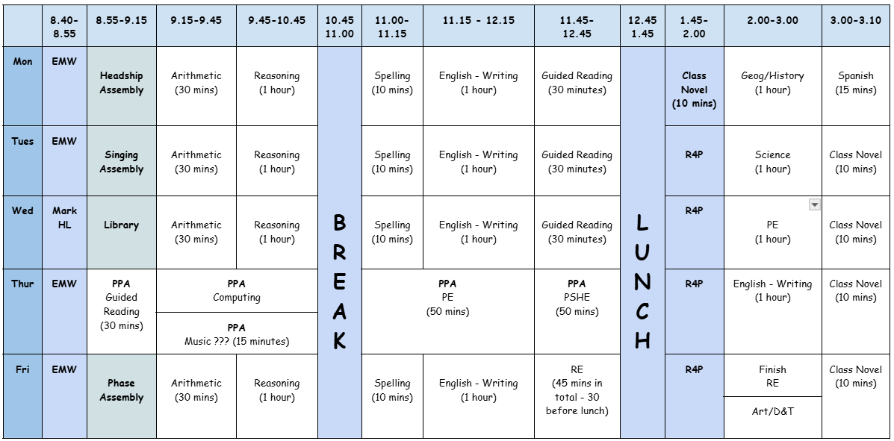
What the school day looks like
Notes:
MK

Slide 13

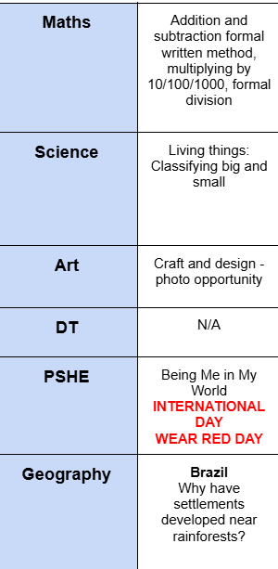
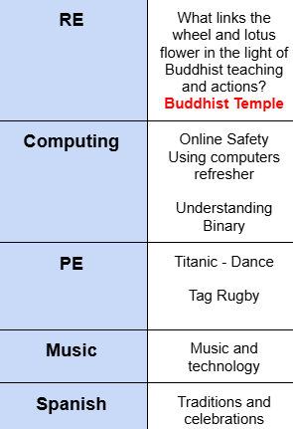
Curriculum Map
Half termly, you will receive a curriculum newsletter.
*We are always evolving our curriculum, so there may be some changes to the above but we will communicate this in the half termly newsletters*
Notes:
MK

Slide 14
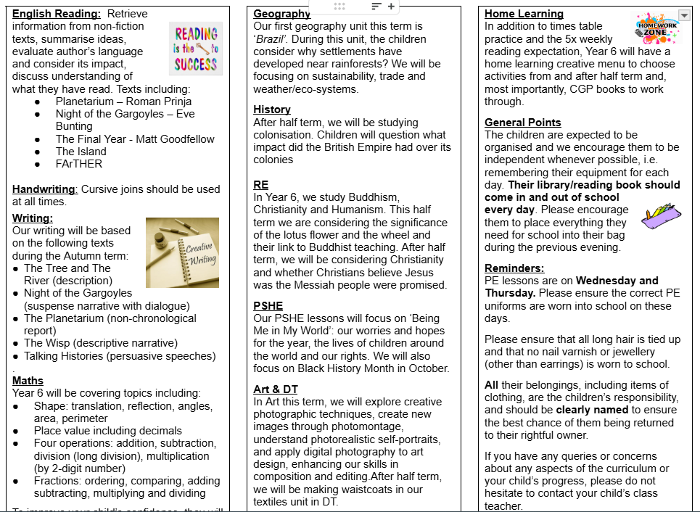
Curriculum Map
Half termly, you will receive a curriculum newsletter.
Notes:
MK

Slide 15
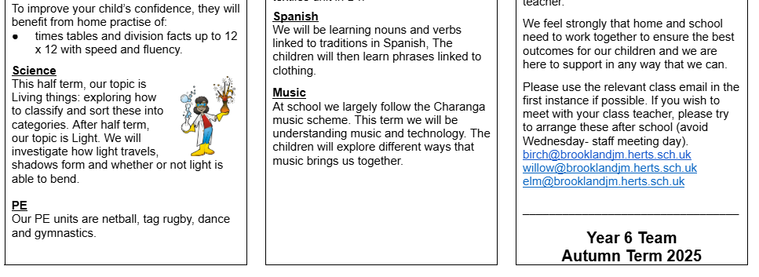
Curriculum Map
Half termly, you will receive a curriculum newsletter.
*We are always evolving our curriculum, so there may be some changes to the above but we will communicate this in the half termly newsletters*

Slide 16
SATs
Your children will be sitting their SATs in May 2026
Monday 11th May 2026 - Thursday 14th May 2026
SPAG – spelling, punctuation and grammar
Reading test
Maths – arithmetic and reasoning paper (x2)
Mock SATs
CGP Books – you have been emailed which revision books should be purchased. We highly recommend them as they are used every week.
Notes:
SH

Slide 17
CGP Revision books
To support the children with revision for SATs, we highly recommend buying CGP revision books.
We offer 2 bundles that can be purchased through school; a standard bundle and a stretch bundle.
The books are much cheaper if you buy them through school as we can purchase at the school price.
The required bundle can be purchased via Arbor from this week. We will leave the payment option open for 2 weeks.
Notes:
SH

Slide 18
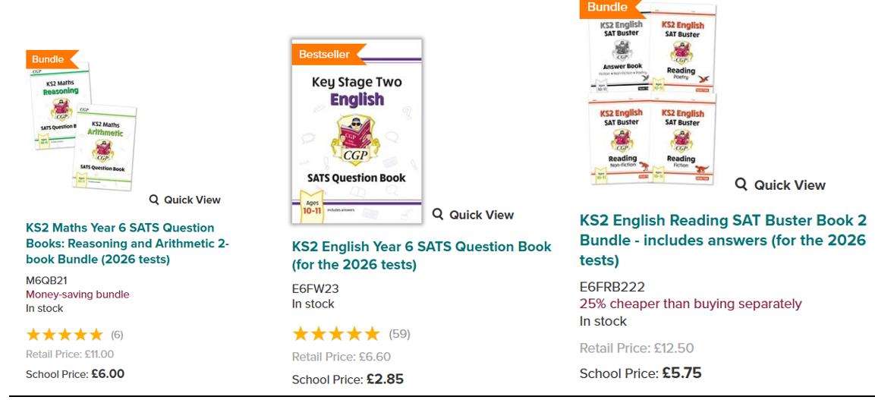
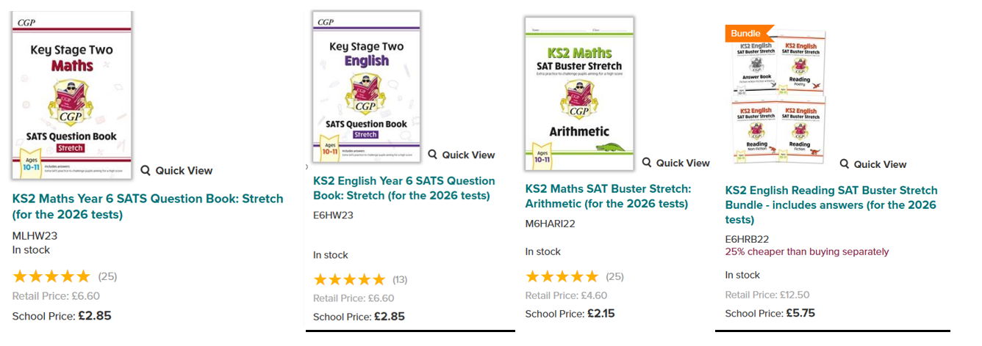
CGP Revision books
Standard bundle - £14.60
Through the school, this bundle can be purchased for £14.60.
Stretch bundle - £13.60
This bundle can be purchased through the school for £13.60.
Notes:
SH

Slide 19
Work in books - Marking and presentation
Teachers will highlight in pink to show that your child has met the learning objective.
Teachers will give personalised verbal feedback to the children during lessons.
Teachers will use green pen to show children where they need to correct spellings or punctuation.
Teachers will give ‘next steps’ in green pen, for children to respond to in purple pen.
Children use purple pen to edit their own work.
Children will be taught to write in blue handwriting pen in a cursive style.
Neat presentation is taught and expected in all written work.
Notes:
OW

Slide 20
Sweets/Treats
no sweets / cakes brought in
puzzles/games and books instead
advice from county and Anaphylaxis UK
Notes:
OW

Slide 21
Lunchtime
Lunchtime is 1 hour long
All lunches are selected on school grid
Nut free school
OPAL
Healthy packed lunch is encouraged (No sweets, fizzy drinks and nut free)
We will have a range of activities at lunch time: social club, film club, origami, dungeons and dragons, various sports clubs, small playground
Children need a snack for break time - fruit or vegetables only
Milk can be ordered and paid for online – speak to the office
Notes:
MK

Slide 22
End of day
All classes keep a list of adults whom you have authorised to collect your child – if this needs updated, please email the office
We will not let a child go with anyone who is not on the list, unless you have notified the office
If you authorise your child to be a ‘walker’ they will be released from the classroom door to meet you at the area you have decided with them
Notes:
MK

Slide 23
Whole School
Positive Behaviour System
4 houses: Amber, Emerald, Ruby and Sapphire
Children who show the Brookland Values (kind, respectful, best) will be recognized with a house point
House points are counted each week and then collated to find the winning team for the term.
Weekly Headteacher’s Award for: Being Kind, Being Respectful/Rights Respecting, Being the Best that you can be and the Risk Taker Award
Notes:
SH

Slide 24
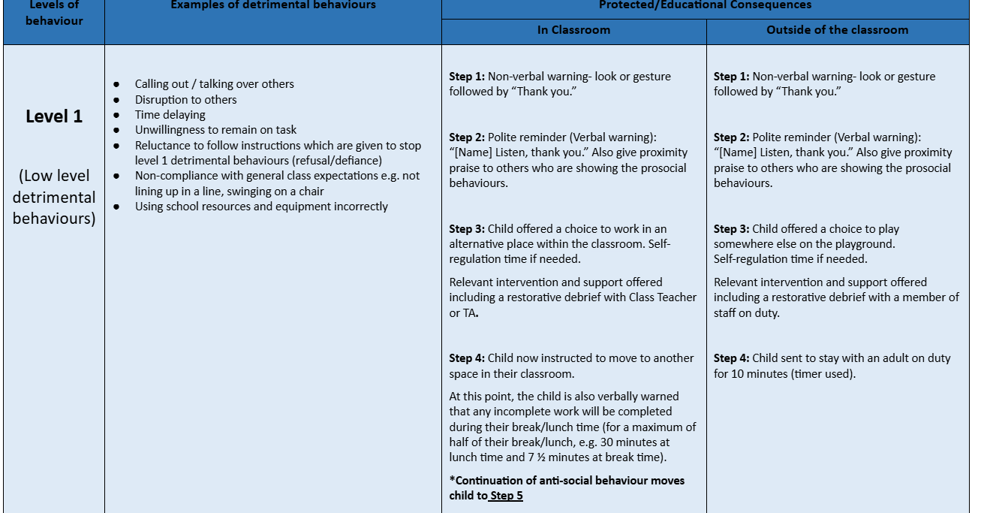
Behaviour Ladder
Notes:
SH

Slide 25
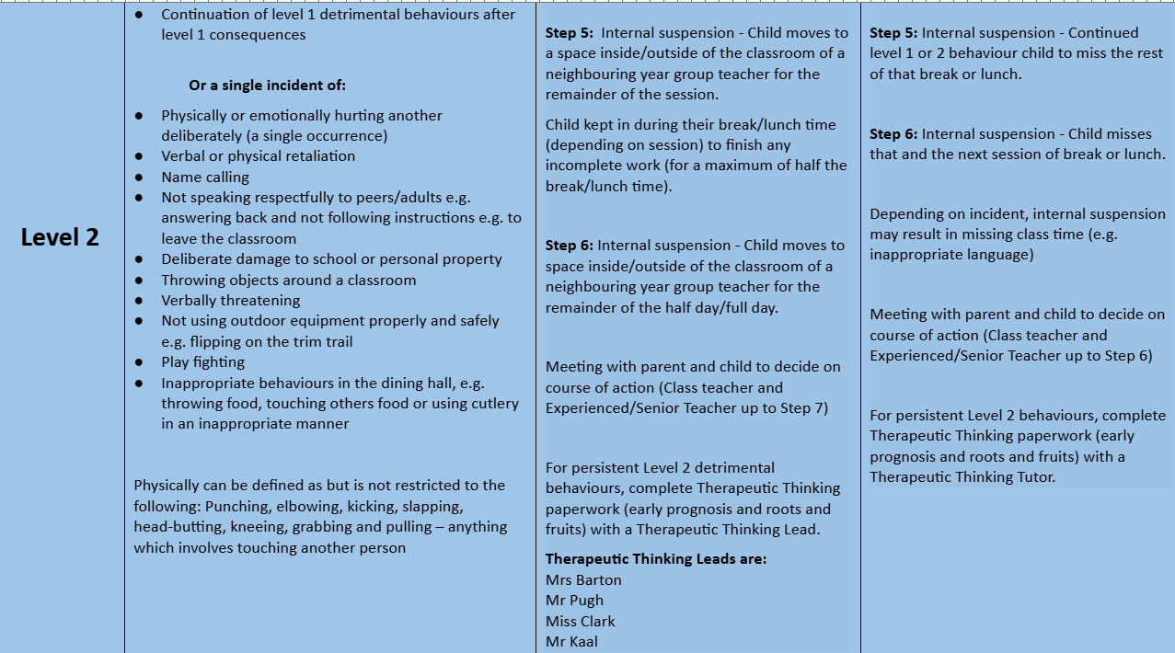
Behaviour Ladder
Notes:
SH

Slide 26
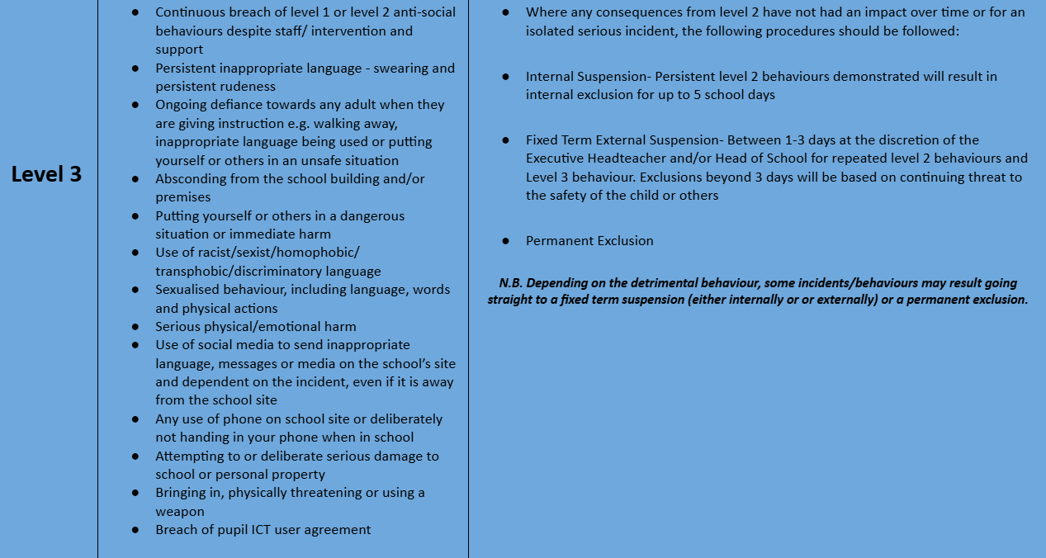
Behaviour Ladder
Notes:
SH

Slide 27
Home Learning
Weekly home learning will be emailed home every Friday, along with Mr Pugh’s weekly newsletter.
Reading – CGP BOOKS comprehensions and reading at least three times a week - A minimum of 20 minutes per reading day to build up stamina.
SPaG/spelling – CGP BOOKS - focuses on spelling, grammar and punctuation we are teaching and/or around Year 5/6 common misconception words
Maths - CGP BOOKS - Until the CGP books are up and running, we will set general maths home learning. Children continue to learn times tables on times table rockstars.
Termly – homework menu which links to the foundation subjects - Children will be given a range of homework activities from which they can choose which tasks to complete. Children are accepted to complete a minimum of 2 tasks but can complete as many as they like
Note – Children will be given the login details for purple mash, Times tables rockstars and google classroom. The children may need these details for some of the home learning that is set.
Notes:
OW

Slide 28
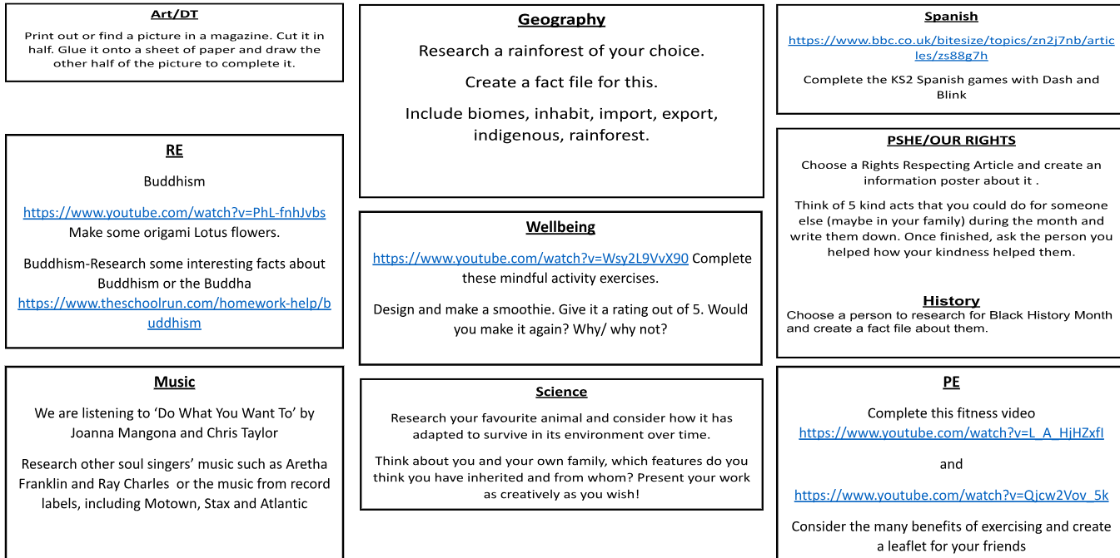
Home Learning Menu
https://docs.google.com/document/d/17ucH3RnDKjTEZxOE_xHhMDwZRZoiGgIOG1272XiH1g0/edit?tab=t.0#heading=h.gjdgxs need to complete for two subjects and screen shot onto slides
Notes:
OW

Slide 29
Clubs and extra-curricular activities
Children have access to range of clubs
Many are at lunchtimes
After school: choir, range of sports (tennis, football, multi-sports, athletics, tag rugby), book & biscuit club and lego
We will be sending out information about clubs this week – depending on the club, sign up will either be by calling Elevate Sports (the sports company who will be running our sports clubs led by Ryan Ladyman) or through Arbor.
Notes:
MK

Slide 30
Medical
Head bumps
  Letter sent home with symptoms to look out for
  Text sent home to inform you
  Coloured wrist band put on child
Medication
  Please let the office know of any changes
  We will call you when medication is coming up to its expiry date so you can replace it
Notes:
MK

Slide 31
Communication at Brookland
Class email – for general classroom enquiries – teachers will aim to reply within 48 hours – please note that teachers do not look at this email during the school day. Emails are mainly checked at the end of the day.
birch@brooklandjm.herts.sch.uk
redwood@brooklandjm.herts.sch.uk
willow@brooklandjm.herts.sch.uk
Admin email: admin@brooklandjm.herts.sch.uk - If you need to communicate change in collection, absence or something urgent then please use the school office email
Mr Pugh’s Weekly Newsletter – usually emailed on a Friday – has upcoming dates, key events in the school, celebration information
Instagram - consents still pending - updated regularly
Phone call or text message
School website
Notes:
SH

Slide 32
Mobile Phones and Social Media
The expectation around mobile phones is that they should be SWITCHED OFF once children are in the school grounds (after they have communicated with parents that they have arrived).
Mobile phones are given back to children AT THE END OF THE DAY and are NOT allowed to be switched on until they leave the school grounds to avoid incidents of filming and irresponsible photos.
The recommended age for WhatsApp, Instagram, Snapchat and TikTok etc is 13 years minimum.
If you have given permission for your child to use such sites – please can you monitor the use of these sites. We are increasingly having incidents of bad language, photos/videos being shared without consent and just general unkindness online.
As a school we are always here to support our children if something is said or written online outside of school, but as we are sure you can understand it is very difficult to deal with things that have not happened on our premises. We really do need parental support with dealing with online issues.
Although something we hope you will not need to do, but if you do find any disturbing content online and on your child’s phone, then you are well within your rights to go to the police.
Children spend a lot of time in school learning about online safety and being kind and it would be really helpful if you could support us in reiterating the same messages at home.
Notes:
SH

Slide 33
Can you help?
Bagels
If you are able to support with prepping bagels in the morning on any day of the week (from 8am until 8:45am) please could you let the office know.
If you are able to help, Mrs Barton is happy to have your children in sunrise club (breakfast club) free of charge.
Even if you can only do one day a week, it would really support us in getting the bagels prepared for the children – the children love the bagels!
PTFA
We have a fabulous PTFA and if you would like to join or just help out, then please keep an eye out for information they will send out.
Notes:
MR PUGH

Slide 34
Thank you very much for attending
‘Kind, Respectful, Best’

