Slide 1

BROOKLAND FEDERATION
Brookland Junior School
‘Kind, Respectful, Best’
Year 3 Meet the teacher
Notes:
Niamh

Slide 2

Welcome to Year 3
Thank you very much for attending
We are all really looking forward to working in partnership with you and teaching our fantastic Year 3 children.
This presentation will give you some key information about Year 3.
Notes:
Niamh

Slide 3
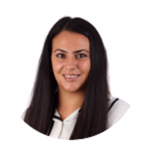
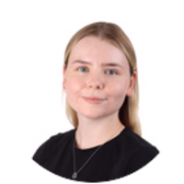


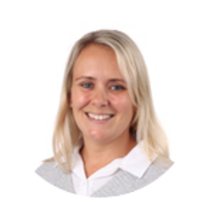
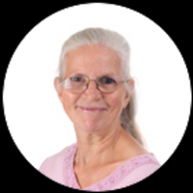
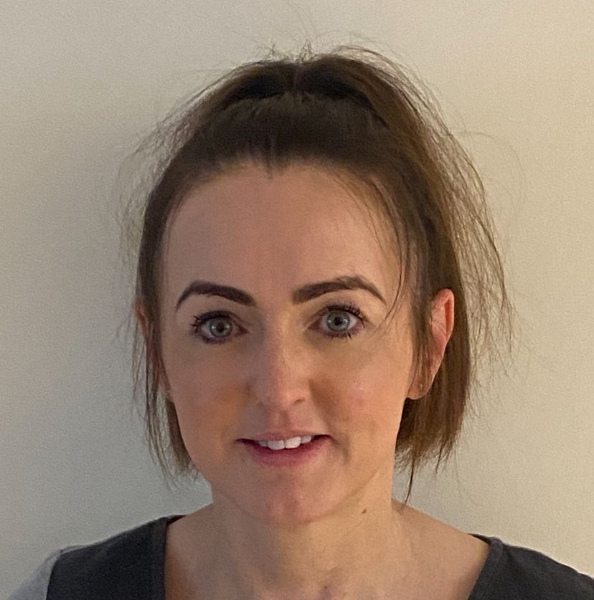
Meet the Year 3 Team
Ms Kypri
Cedar
Class teacher
Miss Bridgeman
Elder
Class teacher
Miss Reilly
Aspen
Class teacher
Mrs Furness
Teaching Assistant
Miss Carruthers
Teaching Assistant
Mrs Phillips
Teaching Assistant
Mrs Huckstep
Learning Support Assistant
Notes:
Niamh

Slide 4
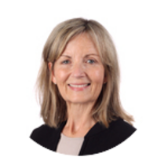


Meet the Year 3
PPA Team
  Mrs Coombs
Mr Cawley
Mrs Moore
Our PPA time will be every Monday morning.
Notes:
Niamh

Slide 5
The Brookland Values
Be KIND
Be RESPECTFUL
Be the BEST that you can be
Notes:
Niamh

Slide 6

Rights Respecting school
Each class has a Class Agreement based on the Unicef Rights of the Child.
The class chooses the rights to focus on such as the right to an education, the right to be safe, the right to relax and play.
We have a weekly session where children learn more about the rights and how they can help everyone to receive their rights.
Notes:
Niamh

Slide 7


We are INCLUSIVE and DIVERSE
The children are at the centre of everything we do
We treat each child as an individual
We acknowledge diversity because we are diverse
We are working on ensuring our curriculum continues to be diverse
We will be using aspects from the ‘No Outsiders: Everyone different, everyone welcome’ scheme which uses children’s literature and real-life news stories to discuss differences and acceptance.
Notes:
Niamh

Slide 8
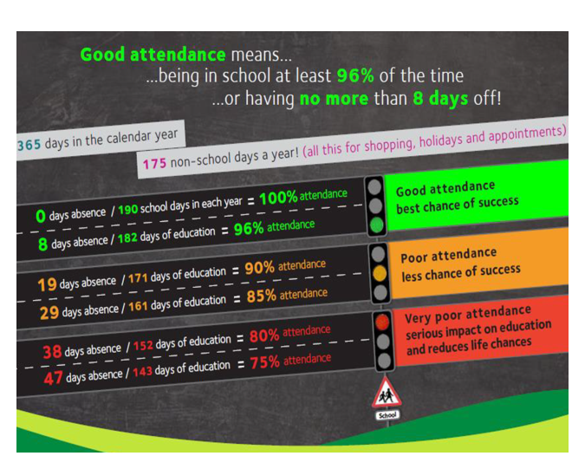
ATTENDANCE MATTERS
We can not stress enough how important it is that your child attends school everyday
We know children get ill, but unless they are really poorly please send them in. Please do not keep them at home for a runny nose, a slight cough etc.
Speak to the office and depending on the circumstances, we are happy to administer calpol or nurofen if needed
Term time holidays will not be authorized
Attendance Policy has further details
Notes:
N

Slide 9
Uniform
We have very high expectations and this starts with uniform.
Please ensure your child comes to school in correct school uniform and PE uniform.
Uniform lists have been previously emailed out and are available on our school website.
No jewelry – except stud earrings, a watch (not SMART), and any jewelry worn for religious reasons – NO bracelets, bangles, rings, nail polish, make up etc. Dark coloured school shoes to be worn on non-PE days.
PE uniform – NO football kits, hoodies or bright trainers. Children can wear their school jumper over their PE uniform.
We recommend your child bringing in a pair of wellies that they keep at school - they will be used for our outdoor lunchtime provision.
We do have coveralls for the children to wear, however, if your child is likely to be fond of water and mud, it may also be useful to put some spare clothing in their school bag.
Notes:
N

Slide 10
What the school day looks like
 | 8.40- 8.55 | 8.50-9.30 | 9.30-10.30 | 10.30- 10.45 | 10.45- 11.45 | 11.45- 12.45 | 12.45- 1.45 | 1.45- 2.00 | 2.00-3.00 | 3.00-3.10
Mon | Register Early Morning Work | Headship Assembly | PSHE | Break Time | PE | Computing | Lunch Time | Register / Reading For Pleasure | English/Maths | Class Novel
Tues | Register Early Morning Work | Spelling | English |  | Maths | RE 11:45-12:30 Library 12:30-12:45 |  |  | Guided Reading PE | Collective Worship
Wed | Register Early Morning Work | Singing Assembly Spelling 9.15-9.30 | English |  | Maths | Guided Reading 11:45-12:15 Music 12:15-12:45 |  |  | History/ Geography | Class Novel
Thurs | Register Marking home learning | Phase Assembly Spelling 9.15-9.30 | English |  | Maths | Guided Reading 11:45-12:15 Timetables 12:15-12:45 |  |  | Science | Class Novel
Fri | Register Early Morning Work | Spanish Spelling Test | English |  | Maths | Guided Reading 11:45-12:15 Handwriting 12:15-12:45 |  |  | DT/ART | Collective Worship
Notes:
N

Slide 11
Lunchtime
Lunchtime is 1 hour long
All lunches are selected on school grid
Nut free school
Healthy packed lunch is encouraged (No sweets, fizzy drinks and nut free)
We will have a range of activities at lunchtime: social club, film club, origami, mud kitchen, small world, bikes, scooters, den building etc
Children need a snack for break time - fruit or vegetables only
Milk can be ordered and paid for online – speak to the office
Notes:
N

Slide 12
End of day
All classes keep a list of adults whom you have authorised to collect your child – if this needs updated, please email the office
We will not let a child go with anyone who is not on the list, unless you have notified the office
If you authorise your child to be a ‘walker’ they will be released from the classroom door to meet you at the area you have decided with them
Notes:
N

Slide 13
Whole School
Positive Behaviour System
4 houses: Amber, Emerald, Ruby and Sapphire
Children who show the Brookland Values (kind, respectful, best) will be recognized with a house point
House points are counted each week and then collated to find the winning team for the term.
Weekly Headteacher’s Award for: Being Kind, Being Respectful/Rights Respecting, Being the Best that you can be and the Risk Taker Award
Notes:
AK

Slide 14
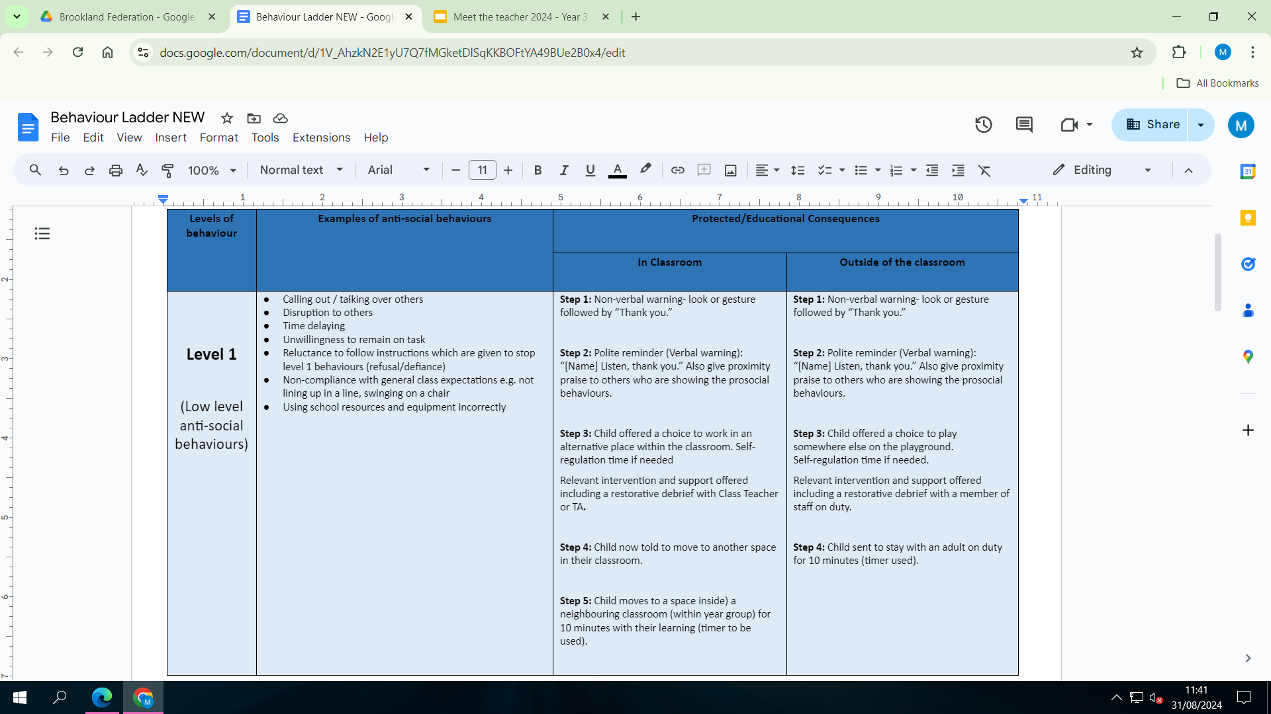
Behaviour Ladder
Notes:
AK

Slide 15
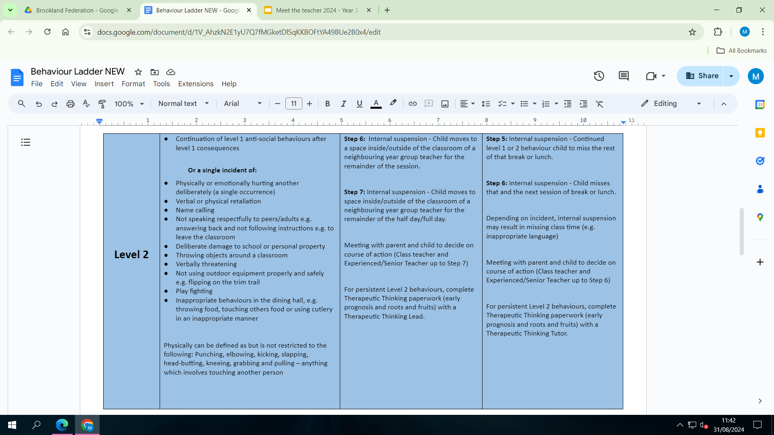
Behaviour Ladder
Notes:
AK

Slide 16
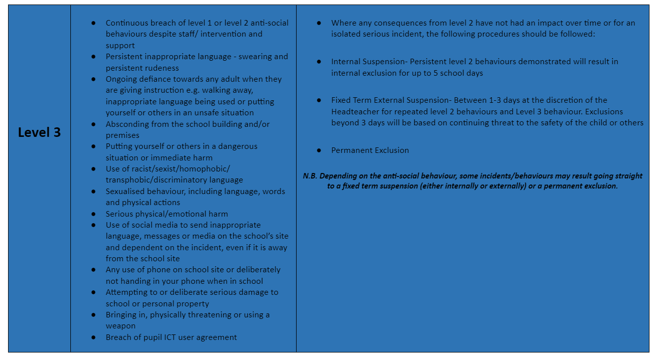
Behaviour Ladder
Notes:
AK

Slide 17
Curriculum
We teach a broad and balanced curriculum covering all areas of the National Curriculum.
In Year 3 we teach 9 lessons of English and Maths over a 2 week period. Guided Reading is taught 4 times a week. Spelling and handwriting are taught separately.
There are 2 PE lessons a week – Monday and Tuesday
Your child will also have weekly lessons in Science, RE, PSHE, Music, Computing, History/Geography, Spanish, Art/DT
Your child may have ‘intervention’ sessions to help them catch up or to give extra support. These are small group or individual sessions, which usually take place in the afternoon.
Notes:
AK

Slide 18
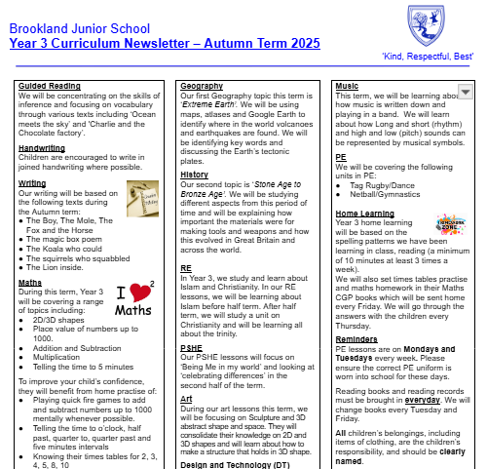
Curriculum Newsletter
Termly, you will receive a curriculum newsletter.
*We are always evolving our curriculum, so there may be some changes to the above but we will communicate this in the half termly newsletters*

Slide 19
Work in books - Marking and presentation
Teachers will highlight in pink to show that your child has met the learning objective.
Teachers will give personalised verbal feedback to the children during lessons.
Teachers will use green pen to show children where they need to correct spellings or punctuation.
Teachers will give ‘next steps’ in green pen, for children to respond to in purple pen.
Children use purple pen to edit their own work.
Children will be taught to write in blue handwriting pen in a cursive style.
Neat presentation is taught and expected in all written work.
Notes:
AK

Slide 20
Equipment
School bag
Water bottle – named - only water
Year 3 children should not bring mobile phones to school
Stationery – we provide everything your child needs so there is no need to bring in their own stationery
No toys/cards/personal belongings to school.
Notes:
AK

Slide 21
Home Learning
Weekly home learning will be emailed home every Friday, along with Mr Pugh’s weekly newsletter.
Home learning will start to be set from Friday 12th September.
Weekly – reading, spelling and maths. All home learning is expected to be completed by the following Thursday. (further details in the next few slides)
Termly – homework menu which links to the foundation subjects - Children will be given a range of homework activities from which they can choose which tasks to complete. Children are expected to complete a minimum of 2 tasks but can complete as many as they like
Notes:
AB

Slide 22
Home Learning - Reading
Reading at home is an expectation (at least three times a week) - A minimum of 10 minutes per day
All children will be given a reading record by this Friday. This should come back and forth to school every day along with your child's current reading book.
Your child’s reading records will be checked every Tuesday and Friday and this is when books will be changed if needed.
Please sign the reading record every time you hear your child read.
Note – when you receive your child’s reading record, on the inside cover will be the login details for purple mash, Times tables rockstars and google classroom. The children may need these details for some of the home learning that is set.
Notes:
AB

Slide 23
Home Learning - Spelling/SPAG
Spellings is not taught through memorised lists
Children will be given a weekly pattern or principle to explore
They will use the pattern or principle to enable them to spell any word that conforms to the principle.
They may also be given a task from the CGP SPAG book
For example
Pattern – root words that end in y.
Principle: to add a suffix to root words ending in y, we must first change the y to an i.
Happy – happiness – happily – happier – happiest
Exceptions – where this would create a double i such as adding the -ing suffix (flying not fliing)
Spelling tests will be 10 words including ones that conform to the pattern or principle and some common words.
Notes:
AB

Slide 24
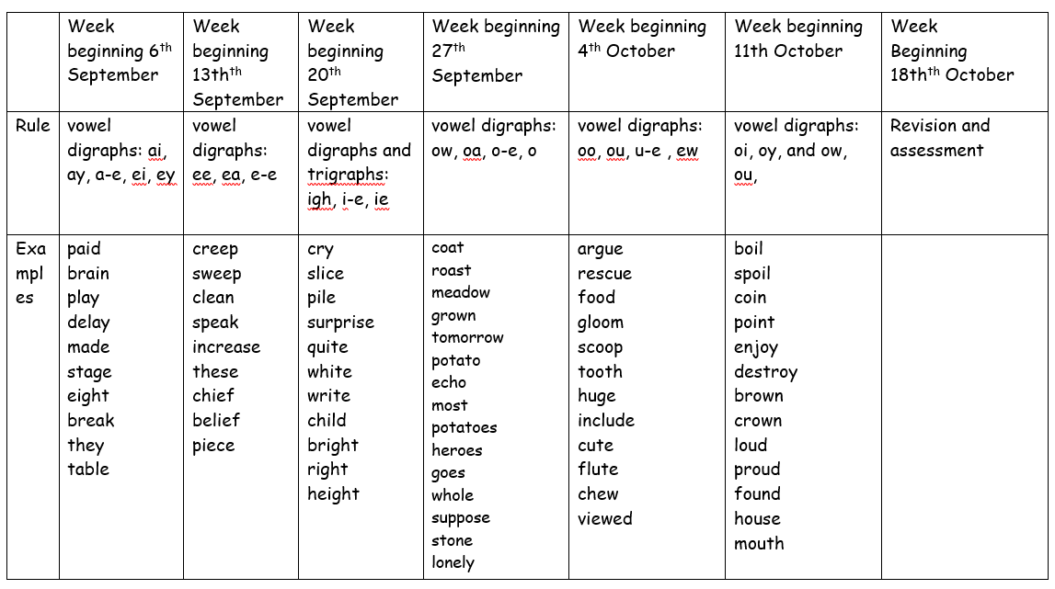
Notes:
AB

Slide 25
Home Learning - Maths
One aspect of maths home learning will be these CGP books. Children will be set a page to complete at home. The CGP book is expected in school on Thursday where we will go through the answers.
Times Tables
In Year 3, children are expected to already know the 2x , 5x and 10 tables (taught in Year 2)
In Year 3 they will learn the 3x, 4x and 8x tables (National Curriculum requirement)
In Year 4 there is a national Multiplication Check – questions from all tables answered at speed
Please support your child by spending time each week learning and practising times tables
Times Tables Rock Stars – We use an online resource to help the children practise their tables. Your child will receive their details and are expected to regularly login to help learn their tables.
Notes:
AB

Slide 26
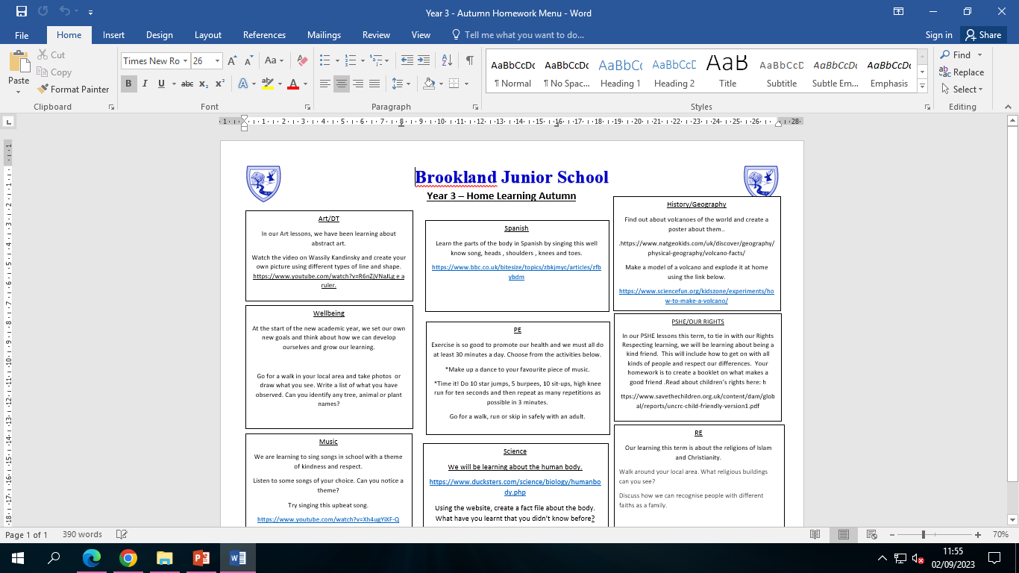
Home Learning Menu
Notes:
AB

Slide 27
Clubs and extra-curricular activities
Children have access to range of clubs
Many are at lunchtimes
After school: choir, range of sports (tennis, football, multi-sports, athletics, tag rugby)
We will be sending out information about clubs this week – depending on the club, sign up will either be by calling Elevate Sports (the sports company who will be running our sports clubs led by Ryan Ladyman) or through Arbor.
Notes:
AB

Slide 28
Medical
Head bumps
  Letter sent home with symptoms to look out for
  Text sent home to inform you
  Coloured wrist band put on child
Medication
  Please let the office know of any changes
  We will call you when medication is coming up to its expiry date so you can replace it
Notes:
AB

Slide 29
Communication at Brookland
Class email – for general classroom enquiries – teachers will aim to reply within 48 hours – please note that teachers do not look at this email during the school day. Emails are mainly checked at the end of the day.
aspen@brooklandjm.herts.sch.uk
cedar@brooklandjm.herts.sch.uk
elder@brooklandjm.herts.sch.uk
Admin email: admin@brooklandjm.herts.sch.uk - If you need to communicate change in collection, absence or something urgent then please use the school office email
Mr Pugh’s Weekly Newsletter – usually emailed on a Friday – has upcoming dates, key events in the school, celebration information
Phone call or text message
School website
Notes:
AB

Slide 30
Can you help?
Bagels
If you are able to support with prepping bagels in the morning on any day of the week (from 8am until 8:45am) please could you let the office know.
If you are able to help, Mrs Barton is happy to have your children in sunrise club (breakfast club) free of charge.
Even if you can only do one day a week, it would really support us in getting the bagels prepared for the children – the children love the bagels.
PTFA (Parent teacher and friends association)
We have a fabulous PTFA and if you would like to join or just help out, then please keep an eye out for information they will send out.
Notes:
AB

Slide 31
Thank you very much for attending
‘Kind, Respectful, Best’
Notes:
AB

